Slide 1
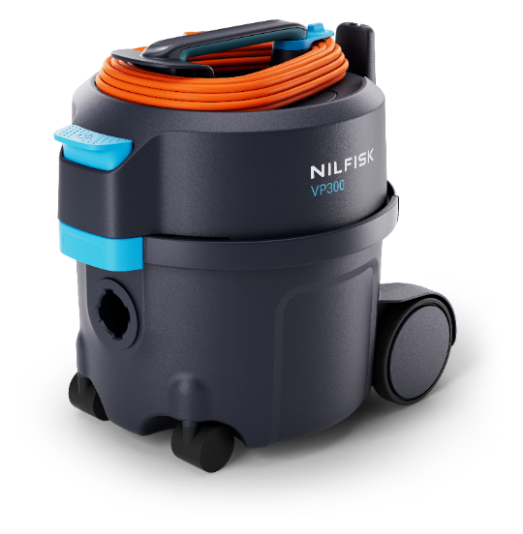
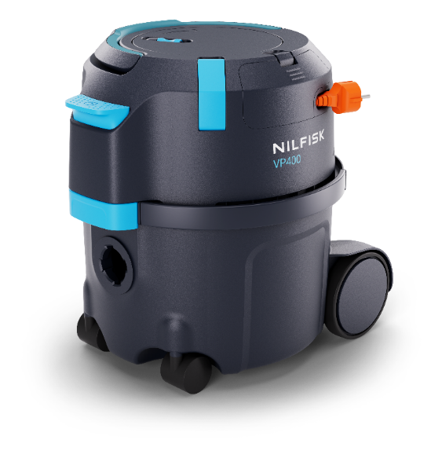
Nilfisk VP300 & VP400 Commercial Dry Vacuums Internal sales presentation

Slide 2
Agenda
1
Background, Brand & Design & Value proposition
6
Accessories
2
Target segments & Strategy
7
Other
3
New range
4
Key selling points
5
Key competition

Slide 3
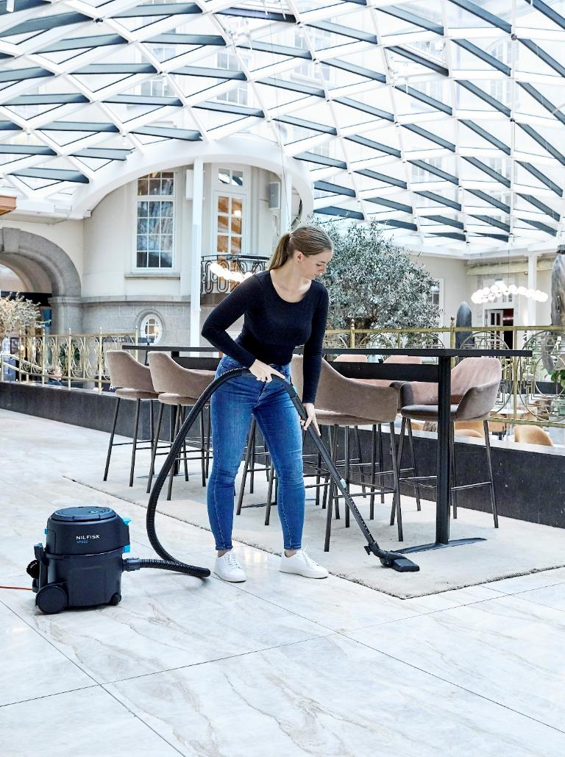
Agenda
1
Background, Brand & Design & Value proposition
6
Accessories
2
Target segments & Strategy
7
Other
3
New range
4
Key selling points
5
Key competition

Slide 4
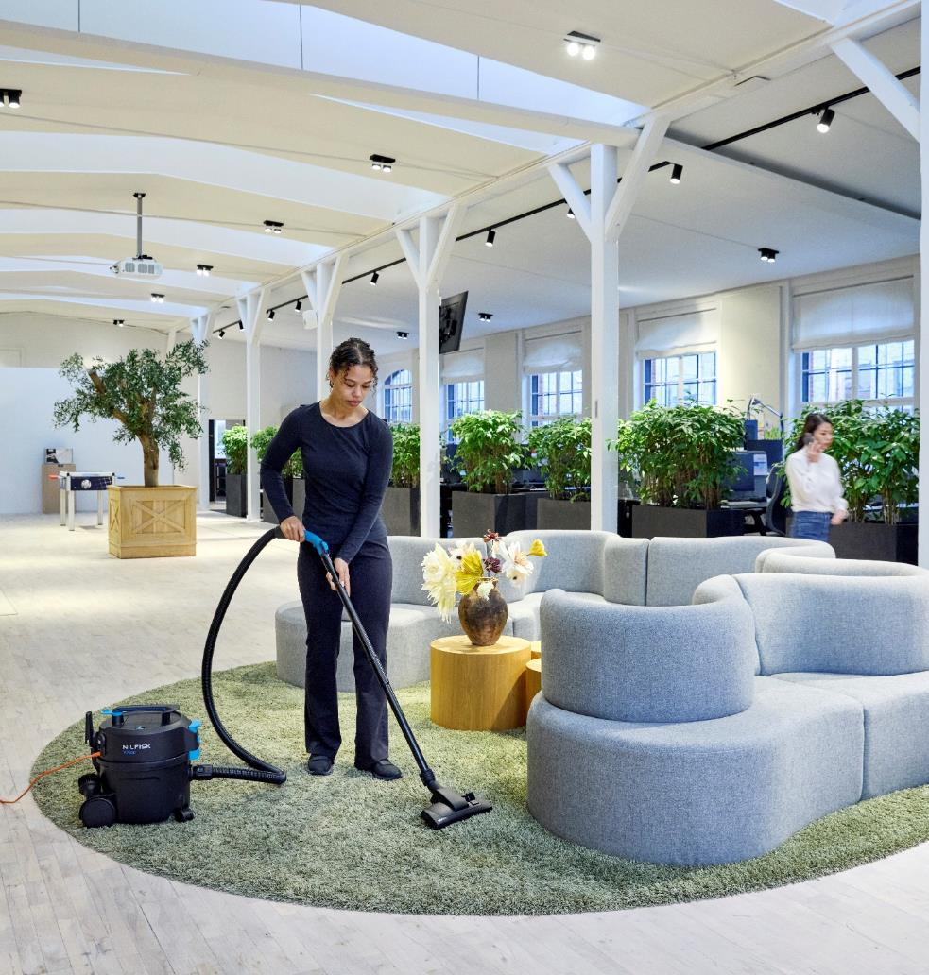
1 | Background
VP300 & VP400
Introducing the new Nilfisk VP300 and VP400 — Commercial dry vacuums targeted for the entry-level area and designed for delivering best-in-class performance across key parameters.
VP300: An enhanced version of the trusted VP300 model
VP400: A durable new addition featuring a convenient cord rewind system, expanding the product range
Both models are thoughtfully engineered with the operator in mind:
Compact & lightweight for effortless handling.
High versatility to adapt to specific customer needs.
Reliability for multiple hours of daily use, delivering consistent high performance.
A user-friendly interface, ensuring intuitive operation even for first-time users.
The VP300 and VP400 combine power and convenience in a small footprint, making them ideal for professionals seeking efficient and reliable cleaning solutions.

Slide 5
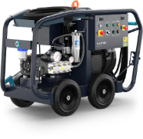
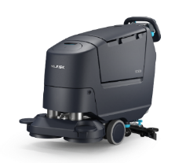
1 | Brand & Design
For internal use only
Next Gen Professional Colour strategy
Primary product body colour
This is the main product colour to be used on all major parts.
New professional (PBLS)
Product colours & ratios
Ergonomic / feature colour
A colour to highlight ergonomic areas (e.g. grip) and product specific features and USPs.
User touchpoint operational colour
Switches, buttons, caps, grips. Any part this colour is needed to be interacted with to operate the machine effectively.
Safety / service colour
Parts this colour indicate safety elements (e.g. charging cables, reverse buttons) and service point.
The new professional CMF palette has been extensively researched, developed and tested – supports intuitive usability.

Slide 6
Key messaging
Introducing the new Compact Dry range
A new formula for simplicity

Slide 7
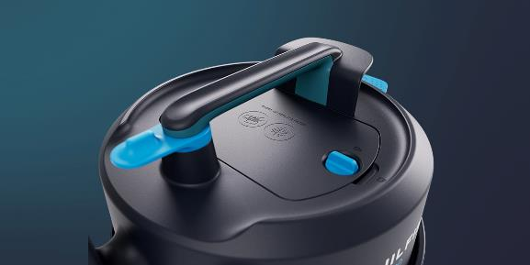
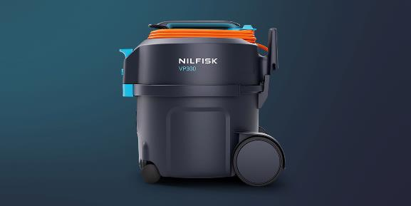
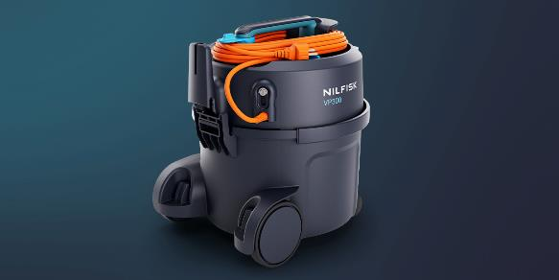
1 | Key values and benefits
Highlights
Power and people-centric​
For cleaning, the VP300 and VP400 are compact, high-performing machines with improved ergonomics and lightweight design to help reduce strain and comply with strict health and safety requirements, all elevating working conditions.
Simple and intuitive ​
Designed for seamless operation, our product offers intuitive touchpoints, easy bag replacement for hassle-free maintenance, and user-friendly features like a foot-operated power switch and convenient cord management. These ensure effortless use, smooth task transitions and enable efficient, uninterrupted work every day.
.
Powerful and productive
Designed for ease and efficiency, our lightweight, ergonomic vacuum reduces strain and is easy to transport. Intuitive touch points and tool-free access simplify bag and filter maintenance, with easy-to-replace prefilters and HEPA filters ensuring optimal air quality while saving time. Versatile attachments are conveniently stored on the machine, keeping everything within reach for efficient, adaptable cleaning.
Engineered for superior performance, this range delivers a deep clean with fewer passes. Its best-in-class net-filling capacity minimises bag changes and saves costs. Compact and agile, it excels in tight spaces and its quiet operation ensures cleaning can be done anytime without disruption.
Convenience at your feet

Slide 8
Campaign Messaging Platform
For internal use only
Value
proposition:
Messaging themes:
Simple & intuitive
Powerful productivity
Convenience
A new formula for simplicity
Value statements:
Designed for seamless operation, our product offers intuitive touchpoints, easy bag replacement for hassle-free maintenance, and user-friendly features like a foot-operated power switch and convenient cord management. These ensure effortless use, smooth task transitions, and enable efficient, uninterrupted work every day.
Engineered for optimal performance, our vacuums delivers a reliable and great cleaning efficiency, while its best-in-class net filling capacity minimises bag changes and saves costs. Compact and agile, it excels in tight spaces, and its quiet operation ensures cleaning can be done anytime without disruption.
Designed for ease and efficiency, our lightweight, ergonomic vacuum reduces strain and is easy to transport. Intuitive touch points and tool-free access simplify bag and filter maintenance, with easy-to-replace prefilters and HEPA filters ensuring optimal air quality while saving time. Versatile attachments are conveniently stored on the machine, keeping everything within reach for efficient and adaptable cleaning.
Your success is at the heart of our solutions. Our new range of compact dry vacuums are designed to be simple, powerful and convenient to help operators work as comfortably and efficiently as possible, so that your team thrives and your business succeeds.
Proof points:
Ease of use – intuitive controls and simple bag replacement make it easy to use, reducing downtime and ensuring hassle-free maintenance.
Effortless maneuverability – thoughtfully designed for easy task transitions and smooth movement across all surfaces
User-friendly operation – foot-operated power switch and operator focused cord management makes it simple to get started and transition to other areas.
Colour-coded touch points intuitively guide users to key interaction areas, complemented by optimised cord management and storage for additional simplicity.
Engineered for high-performance - captures dust, dirt, and debris with ease, ensuring a reliable and great cleaning efficiency
Certified HEPA filter designed for quick, tool-free checks and replacements, ensuring sustained optimal suction power
Best in class net filling capacity – less time changing bags, more time cleaning, save money on bags.
Compact size - an agile vac well suited for effective cleaning in congested environments.
Quiet – Operate without disturbing others – expands times you can clean
Ergonomic, light-weight design with improved handles. Bent-ends and latch – easy and comfortable to operate and transport which reduces strain
No-tool maintenance – allows operators to quickly and easily access bag and filters.
Prefilter and HEPA filter are easy to check and replace to maintain suction power and cleaning performance
Versatile cleaning – multiple cleaning attachments are conveniently stored on the machine so they are always within reach.

Slide 9
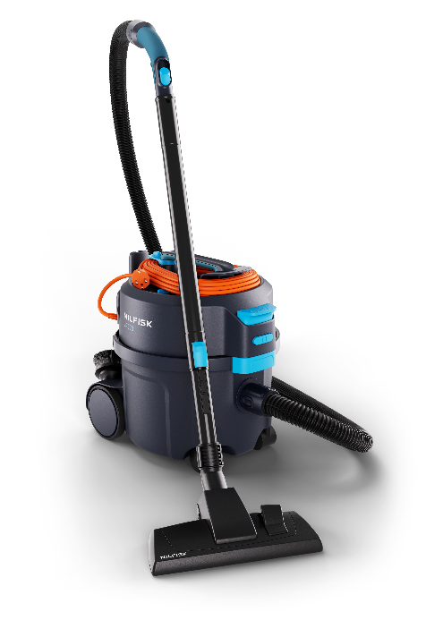
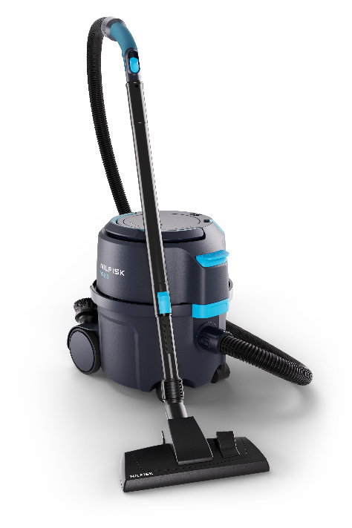
1 | Messaging themes – VP300 & VP400
Key messaging details
VP300 – an improved success
Compact & Lightweight
Reliable
Simple - High productivity
VP400 – new (and best) in class
Efficient
Durable rewind
No struggle – Save time and cost
.
VP300 excels with its new, vibrant, next-generation design. The lightweight design features improved ergonomics on the handle, lock and bent-ends, reducing strain. It also has best-in-class filling capacity and seamless cord management. Furthermore, its quiet operation expands cleaning hours.
The VP400 excels with outstanding performance and convenience, whilst being compact for time-saving productivity. A top feature is its smooth cord rewind, eliminating the risk of time-consuming cord mess the next day. Combined with the foot-reachable power switch, it ensures seamless transitions to other areas.

Slide 10
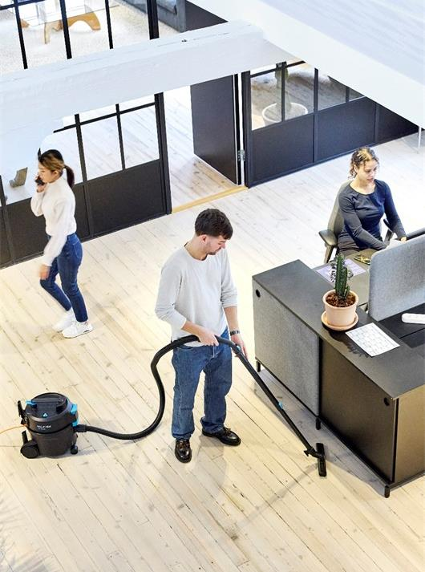
Agenda
1
Background, Brand & Design & Value proposition
6
Accessories
2
Target segments & Strategy
7
Other
3
New range
4
Key selling points
5
Key competition

Slide 11
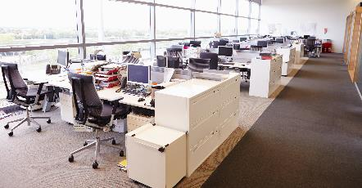
2 | Target segments
Primary customers | CC&I
Contract Cleaners
Institutions
Hospitality
Public administration and offices
Education
Health care
Retail

Slide 12
2 | Customer insights
Highlighted insights
Size & weight are key
Difficult & time consuming to change HEPA
Non-ergonomic touch points currently
Power switch and latch a bit exposed on VP300 (robustness)
Market cord management/handling challenges in general → cords breaking more easily
Small tool storage clips falling off easily/getting lost Overall wish for improved featured models (rewind & cordless)
Current battery and rewind model too heavy and big
Enhance durability (rewind)
Better cordless performance (cordless)
High pricing on current battery and rewind
For internal use only
CCI identified drivers & highlighted customer needs
Key overall drivers and key focus areas for range
Job efficiency
Drivers
Time is a constant challenge for businesses (labour costs) and cleaners (get job done). Need to optimise performance/time efficiency.
Key focus
Features supporting time saving, convenience and productivity
Features enhancing ss
Intuitive usability – clear touchpoints and visual simplicity
Easy to replace consumables and spare parts
Solution reliability
Drivers
Need to reduce downtime related risks of cleaning/business disruptions
Rising prevalence of TCO mindset. How easy and affordable is the vac to maintain and repair?
Key focus
Enhanced durability
Optimising repairability/part replaceability (easy/quick swap) to make service and maintenance as time and cost-effective as possible.
Operator comfort, health and safety
Drivers
Compliance to stricter health and safety regulations
Facing labour shortages and high staff turnover, working environment is increasingly a key focus area to attract and retain staff
Many cleaners experience vac handling/carrying as physically straining
Key focus
Improved ergonomics
Reduced strain
Reducing weight
Sustainability
Drivers
Growing importance of green cleaning positioning/sustainability as business qualifier – especially for medium/ large CCs.
Key focus
Increased product lifetime through enhanced durability and repairability/replaceability of parts and consumables
Improved energy efficiency
Recycled content

Slide 13
2 | Product Strategy
For internal use only
Less platforms & stronger/clearer feature-model positioning
Better
New VP300
New feature model 1 (rewind)
New feature model 2 (cordless)
VP300
VP600
VP600 Auto-Rewind VP600 Battery
GD1000
Best
New GD1000
COMPANY CONFIDENTIAL

Slide 14
Agenda
1
Background, Brand & Design & Value proposition
6
Accessories
2
Target segments & Strategy
7
Other
3
New range
4
Key selling points
5
Key competition

Slide 15
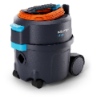
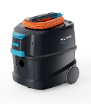
3 | New range overview
For internal use only
Pruned, To be pruned & New
Platform pruned
Platform pruned
Platform pruned
To be pruned later
To be pruned
New
New
VP300
VP600
VP600 Rewind
VP600 Battery
GD1000
VP300 Basic
VP300
VP300 S2
VP300 R
VP400
VP400 S2
VP400 R
To be replaced by
To be replaced by
VP500
VP700
New
New

Slide 16
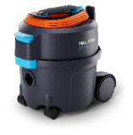
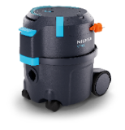
3 | New range positioning
Future model positioning (recommendation):
VP300 is targeted for the entry level area as a reliable light weight machine with a high performance vs positioning
Keep relative price positioning as today on VP300, where we have a good market grip/volume (with local adjustment flexibility) – please ensure to position the model against a comparable competitor with regards to functionality vs price → gaining m-shares is the overarching objective
Especially rewind offering should be much lower priced vs today (slightly above VP300 models)
PAC (if too high priced, loosing both PAC + machine sales) – price vs main competition
For internal use only
Relative positioning as VP300 today | Be competitive locally
Customer need / focus* vs Model positioning
Price focus** and simplicity
Ease of use (Price)
Productivity and Comfort
(Ease of use/Reliability)
Non price sensitive***;
Special need/Flexibility (e.g. cordless or long life), Performance
Future models
(new)
New VP300
New VP400
Old models
(to be outphased)
VP300
VP600 rewind*
* Selected areas (a bit ‘simplified’ view) ** VP600 way-overpriced today and not matching c-needs nor delivering perf reflecting practical market position → Off-positioned
*** Upfront investment

Slide 17
3 | New range upgrades
VP300 & VP400
Improved serviceability
Filter; easy access/no tools
Detachable cord on majority of range*
Performance/Efficiency/Durability
Improved performance +10% despite reducing energy consumption by -12,5%
Best in class sound level - Reduced 3-4dB
New rewind tested to outlive VAC life**
Enhanced UX/Convenience
New VP300 similar weight & size as old
Highlighted touch points
Ergonomic shaped touch points (Handle, bent-end, latch)
Multiple cord storage options (triple on VP300)
Cord Quick-release (VP300; fast start up every day)
Durable large power switch
Icon & illustration guidance
Easy hose repair/replacement
Modernised design
Keeping ref to old despite new design and branding
Improved packaging content (selling points)
Service/maintenance kits
Light (5x bags, 1x HEPA, 1x Motor filter)
Plus (20x bags, 1x HEPA, 1x Motor filter)
398 mm / 15.66 in
340 mm / 13.38 in
395 mm /
15.55 in
* All VP400 models, most VP300
** by “normal use”

Slide 18
3 | Product comparison – Tech specs
For internal use only
VP300 & VP400 vs old range
 |  |  | VP300 & VP400 |  |  |  | Outphased models
 |  |  | EU/UK/CH/ZA | US & CN | JP & AU/NZ |  | Old VP300 EU/UK | Old VP300 INT | Old VP300 US & JP | VP600 EU
Rated Power | W |  | 700 | 700 | 1200 |  | 800 | 1200 | 900 | 730
Suction Power (end of tube) – claim (test) | W |  | 225 (210) | 225 (195-210) | 250 (250) |  | 215 (175-190) | 260 (200) | 150 | 150-200
Airflow (end of tube) – claim (test) | l/s |  | 32 | 32 | 33 |  | 32 | 32 (29) | 32 (29) | 24-30 (24-26)
Vacuum at nozzle – claim (test) | kPa |  | 22 | 22 | 23 |  | 22 | 23 (21) | 19 (19) | 22 (18)
Working sound level @2m (IEC 60335-2-69) | dB(A) |  | 51 | 51 | 52 |  | - | - | - | -
Sound power level (IEC 60335-2-69) – claim (test) | dB(A) |  | 69 (68-70) | 69 (68-70) | 70 (69-71) |  | 73 (71-74) | 69 (73) | 69 (72) | 74
Dimensions (LxWxH) |  |  | 398x340x395 |  |  |  | 395x340x390 |  |  | 480x300x270

Slide 19
3 | VP300 Technical spec
For internal use only
Technical specification of range
 | Country variant |  | EU or CH |  |  |  |  |  |  |  | UK |  |  |  | INT |  | APAC |  |  |  |  |  |  |  | US
 | Item number |  | 107421144 | 107421143 | 107421145 | 107421142 | 107421156 | 107421157 | 107421149 |  | 107421146 | 107421147 | 107421159 |  | 107421155 |  | 107421150 | 107421151 | 107421152 | 107421153 | 107421160 | 107421154 | 107421158 |  | 107421148
 | Description | Note | VP300 HEPA BASIC EU | VP300 HEPA EC EU | VP300 HEPA XT EU | VP300 HEPA EP S2 EU | VP300 HEPA PINK T EU | VP300 R HEPA T EU | VP300 HEPA TC CH |  | VP300 HEPA C UK | VP300 HEPA ECP S2 UK | VP300 R HEPA EC UK |  | VP300 ZA |  | VP300 R BASIC XC JP | VP300 R HEPA BASIC XC JP | VP300 C AU/NZ | VP300 HEPA TC AU/NZ | VP300 HEPA PINK EC AU/NZ | VP300 BASIC C CN | VP300 HEPA XT CN |  | VP300 HEPA C US
Technical data
Voltage/Frequency | V/Hz |  | 220-240/ 50-60 | 220-240/ 50-60 | 220-240/ 50-60 | 220-240/ 50-60 | 220-240/ 50-60 | 220-240/ 50-60 | 220-240/ 50-60 |  | 220-240/ 50-60 | 220-240/ 50-60 | 220-240/ 50-60 |  | 220-240/ 50-60 |  | 100/ 50-60 | 100/ 50-60 | 240/ 50-60 | 240/ 50-60 | 240/ 50-60 | 220-230/ 50-60 | 220-230/ 50-60 |  | 120/60
Protection class / IP protection |  |  | II / IP20 | II / IP20 | II / IP20 | II / IP20 | II / IP20 | II / IP20 | II / IP20 |  | II / IP20 | II / IP20 | II / IP20 |  | II / IP20 |  | II / IP20 | II / IP20 | II / IP20 | II / IP20 | II / IP20 | II / IP20 | II / IP20 |  | II / IP20
Rated Power | W |  | 700 | 700 | 700 | 700 | 700 | 700 | 700 |  | 700 | 700 | 700 |  | 700 |  | 1200 | 1200 | 1200 | 1200 | 1200 | 800 | 800 |  | 800
Suction Power (end of tube) | W |  | 225 | 225 | 225 | 225 | 225 | 225 | 225 |  | 225 | 225 | 225 |  | 225 |  | 250 | 250 | 250 | 250 | 250 | 225 | 225 |  | 225
Airflow (end of tube) | l/s |  | 32 | 32 | 32 | 32 | 32 | 32 | 32 |  | 32 | 32 | 32 |  | 32 |  | 33 | 33 | 33 | 33 | 33 | 32 | 32 |  | 32
Vacuum at nozzle | kPa |  | 22 | 22 | 22 | 22 | 22 | 22 | 22 |  | 22 | 22 | 22 |  | 22 |  | 23 | 23 | 23 | 23 | 23 | 22 | 22 |  | 22
Working sound level @2m (IEC 60335-2-69) | dB(A) | Sound pressure level at working position; 2m distance | 51 | 51 | 51 | 51 | 51 | 51 | 51 |  | 51 | 51 | 51 |  | 51 |  | 52 | 52 | 52 | 52 | 52 | 51 | 51 |  | 51
Sound pressure level @1m (IEC 60335-2-69) | dB(A) |  | 56 | 56 | 56 | 56 | 56 | 56 | 56 |  | 56 | 56 | 56 |  | 56 |  | 57 | 57 | 57 | 57 | 57 | 56 | 56 |  | 56
Dust bag capacity | L |  | 10 | 10 | 10 | 10 | 10 | 10 | 10 |  | 10 | 10 | 10 |  | 10 |  | 15 | 15 | 15 | 15 | 15 | 10 | 10 |  | 10
Main filter type |  |  | HEPA 13 | HEPA 13 | HEPA 14 | HEPA 14 | HEPA 13 | HEPA 13 | HEPA 13 |  | HEPA 13 | HEPA 13 | HEPA 13 |  | Standard |  | Standard | HEPA 13 | Standard | HEPA 13 | HEPA 13 | Standard | HEPA 13 |  | HEPA 14
Main filter area | cm² |  | 2400 | 2400 | 2400 | 2400 | 2400 | 2400 | 2400 |  | 2400 | 2400 | 2400 |  | - |  | - | 2400 | - | 2400 | 2400 | - | 2400 |  | 2400
Cord length | m |  | 10 | 10 | 15 | 10 | 10 | 10 | 10 |  | 10 | 10 | 10 |  | 10,5 |  | 15 | 15 | 10 | 10 | 10 | 10 | 15 |  | 10
Working radius | m |  | 12,5 | 12,5 | 17,5 | 12,5 | 12,5 | 12,5 | 12,5 |  | 12,5 | 12,5 | 12,5 |  | 13 |  | 17,5 | 17,5 | 12,5 | 12,5 | 12,5 | 12,5 | 17,5 |  | 12,5
Weight (machine) | Kg | machine only | 4,5 | 4,5 | 4,5 | 4,5 | 4,5 | 4,5 | 4,5 |  | 4,5 | 4,5 | 4,5 |  | 4,5 |  | 5 | 5 | 5 | 5 | 5 | 5 | 5 |  | 5
Dimensions (LxWxH) | mm |  | 398x340x395 | 398x340x395 | 398x340x395 | 398x340x395 | 398x340x395 | 398x340x395 | 398x340x395 |  | 398x340x395 | 398x340x395 | 398x340x395 |  | 398x340x395 |  | 398x340x395 | 398x340x395 | 398x340x395 | 398x340x395 | 398x340x395 | 398x340x395 | 398x340x395 |  | 398x340x395
Features
Detachable cord |  |  |  | • | • | • | • | • | • |  | • | • | • |  | • |  |  |  | • | • | • |  | • |  | •
HEPA Filtration |  |  | • | • | • | • | • | • | • |  | • | • | • |  |  |  |  | • |  | • | • |  | • |  | •
Recycled material |  |  |  |  |  |  |  | • |  |  |  |  | • |  |  |  | • | •
Durable rewind system
Silent mode |  | (Dual speed) |  |  |  | • |  |  |  |  |  | •
Dual cord storage
Triple cord storage |  |  | • | • | • | • | • | • | • |  | • | • | • |  | • |  | • | • | • | • | • | • | • |  | •
Tube parking |  |  | • | • | • | • | • | • | • |  | • | • | • |  | • |  | • | • | • | • | • | • | • |  | •
Tool storage |  |  | • | • | • | • | • | • | • |  | • | • | • |  | • |  | • | • | • | • | • | • | • |  | •
Ergonomic handle |  |  | • | • | • | • | • | • | • |  | • | • | • |  | • |  | • | • | • | • | • | • | • |  | •
Ergo bent-end |  |  | • | • | • |  | • | • | • |  | • | • | • |  | • |  | • | • | • | • | • | • | • |  | •
Ergo+ bent-end |  | 2k/soft overmold |  |  |  | • |  |  |  |  |  | •
Dust bags |  |  | 1-P | 1-P | 1-P | 1-P | 1-P | 1-P | 1-P |  | 1-P | 1-P | 1-P |  | 1-P |  | 1-P | 1-P | 1-P | 1-P | 1-P | 1-P | 1-P |  | 1-P
*Co-branded/private label models not included in sales presentation

Slide 20
3 | VP300 Configuration
For internal use only
How are the machines equipped?
 | Country variant |  | EU or CH |  |  |  |  |  |  |  | UK |  |  |  | INT |  | APAC |  |  |  |  |  |  |  | US
 | Item number |  | 107421144 | 107421143 | 107421145 | 107421142 | 107421156 | 107421157 | 107421149 |  | 107421146 | 107421147 | 107421159 |  | 107421155 |  | 107421150 | 107421151 | 107421152 | 107421153 | 107421160 | 107421154 | 107421158 |  | 107421148
 | Description | Note | VP300 HEPA BASIC EU | VP300 HEPA EC EU | VP300 HEPA XT EU | VP300 HEPA EP S2 EU | VP300 HEPA PINK T EU | VP300 R HEPA T EU | VP300 HEPA TC CH |  | VP300 HEPA C UK | VP300 HEPA ECP S2 UK | VP300 R HEPA EC UK |  | VP300 ZA |  | VP300 BASIC XC JP | VP300 HEPA BASIC XC JP | VP300 C AU/NZ | VP300 HEPA TC AU/NZ | VP300 HEPA PINK EC AU/NZ | VP300 BASIC C CN | VP300 HEPA XT CN |  | VP300 HEPA C US
Accessories
Tubes
Extension tube steel D32 – Black | 140 8246 040 |  | • |  |  |  |  |  |  |  | • |  |  |  | • |  |  |  | • |  |  | • |  |  | •
Extension tube aluminium – Black | 107421471 | new PN |  | • |  | • |  |  |  |  |  | • | • |  |  |  |  |  |  |  | •
Telescopic tube aluminium – Black/Blue | 107421463 | new PN |  |  | • |  | • | • | • |  |  |  |  |  |  |  |  |  |  | • |  |  | •
Extension tube steel 450 mm | 140 8246 050 |  |  |  |  |  |  |  |  |  |  |  |  |  |  |  | • | •
Hose & Bent-end
Hose CPL W Bent-end D32 | 107421450 |  | • | • | • |  | • | • | • |  | • |  | • |  | • |  | • | • | • | • | • | • | • |  | •
Hose CPL W Bent-end PREM D32 | 107421451 |  |  |  |  | • |  |  |  |  |  | •
Bent-end | 107421446
Bent-end PREM | 107421445
Hose W Connectors | 107421449
Floor Nozzles
Multi surface nozzle | 140 6700 540 |  | • |  | • | • | • | • | • |  |  |  |  |  | • |  |  |  |  |  |  |  | •
Combi nozzle RD295P W.Clip | 107417790 |  |  | • |  |  |  |  | • |  |  | • |  |  |  |  |  |  |  | • |  |  |  |  | •
Combi nozzle RD295 | 140 8492 520
Combi nozzle RD277 | 107411677 |  |  |  |  |  |  |  |  |  | • |  | • |  |  |  |  |  | • |  | • | •
Combi nozzle JP | 107405141 |  |  |  |  |  |  |  |  |  |  |  |  |  |  |  | • | •
Filters & Bags
HEPA 13 filter | 147 1250 600 |  | • | • |  |  | • | • | • |  | • | • | • |  |  |  |  | • |  | • | • |  | •
HEPA 14 filter | 107421443 |  |  |  | • | • |  |  |  |  |  |  |  |  |  |  |  |  |  |  |  |  |  |  | •
Standard filter | 107421444 |  |  |  |  |  |  |  |  |  |  |  |  |  | • |  | • |  | • |  |  | •
Sack prefilter | 147 1432 500 |  |  | • | • | • | • | • | • |  | • | • | • |  | • |  | • | • | • | • | • | • | • |  | •
Motor filter | 140 1535 510 |  | • | • | • | • | • | • | • |  | • | • | • |  | • |  | • | • | • | • | • | • | • |  | •
Fleece dust bag 10-P | 82367820
Paper dust bag 5-P | 82367810
Paper dust bag 10-P | 140 8618 000
Reusable dust bag 1-P (cloth) | 22251800
Maintenance Kit VP300 – LIGHT | 107421454 | fits also VP400
Maintenance Kit VP300 – PLUS | 107421455 | fits also VP400
Other accessories
Round brush | 140 8244 500 |  | • | • | • | • | • | • | • |  | • | • |  |  | • |  | • | • | • | • | • | • | • |  | •
Crevice nozzle | 147 0146 500 |  | • | • | • | • | • | • | • |  | • | • |  |  | • |  | • | • | • | • | • | • | • |  | •
Premium HF nozzle 350mm | 107413080 | grey currently
Premium HF nozzle 495mm | 107413081 | grey currently
Radiator crevice | 81530400 | grey currently
*Co-branded/private label models not included in sales presentation

Slide 21
3 | VP400 Technical Spec
For internal use only
Technical specification of range
 | Country variant |  | EU or CH |  |  |  |  |  | UK |  | APAC |  |  | US
 | Item number |  | 107421169 | 107421171 | 107421172 | 107421177 | 107421173 |  | 107421170 |  | 107421175 | 107421176 |  | 107421174
 | Description |  | VP400 HEPA XEC EU | VP400 HEPA XT EU | VP400 HEPA EC EU | VP400 R HEPA T EU | VP400 HEPA XTCP CH |  | VP400 HEPA XECP UK |  | VP400 HEPA XTCP AU/NZ | VP400 HEPA X CN |  | VP400 HEPA CP US
Technical data
Voltage/Frequency | V/Hz |  | 220-240/50-60 | 220-240/50-60 | 220-240/50-60 | 220-240/50-60 | 220-240/50-60 |  | 220-240/50-60 |  | 240/50-60 | 220-230/50-60 |  | 120/60
Protection class / IP protection |  |  | II / IP20 | II / IP20 | II / IP20 | II / IP20 | II / IP20 |  | II / IP20 |  | II / IP20 | II / IP20 |  | II / IP20
Rated Power | W |  | 700 | 700 | 700 | 700 | 700 |  | 700 |  | 1200 | 800 |  | 800
Suction Power (end of tube) | W |  | 225 | 225 | 225 | 225 | 225 |  | 225 |  | 250 | 225 |  | 225
Airflow (end of tube) | l/s |  | 32 | 32 | 32 | 32 | 32 |  | 32 |  | 33 | 32 |  | 32
Vacuum at nozzle | kPa |  | 22 | 22 | 22 | 22 | 22 |  | 22 |  | 23 | 22 |  | 22
Working sound level @2m (IEC 60335-2-69) | dB(A) |  | 51 | 51 | 51 | 51 | 51 |  | 51 |  | 52 | 51 |  | 51
Sound pressure level @1m (IEC 60335-2-69) | dB(A) |  | 56 | 56 | 56 | 56 | 56 |  | 56 |  | 57 | 56 |  | 56
Dust bag capacity | L |  | 10 | 10 | 10 | 10 | 10 |  | 10 |  | 15 | 10 |  | 10
Main filter type |  |  | HEPA 13 | HEPA 14 | HEPA 13 | HEPA 13 | HEPA 14 |  | HEPA 13 |  | HEPA 13 | HEPA 13 |  | HEPA 14
Main filter area | cm² |  | 2400 | 2400 | 2400 | 2400 | 2400 |  | 2400 |  | 2400 | 2400 |  | 2400
Cord length | m |  | 15 | 15 | 10 | 10 | 15 |  | 15 |  | 15 | 15 |  | 10
Working radius | m |  | 17,5 | 17,5 | 12,5 | 12,5 | 17,5 |  | 17,5 |  | 17,5 | 17,5 |  | 12,5
Weight (machine) | Kg |  | 5,5 | 5,5 | 5,5 | 5,5 | 5,5 |  | 5,5 |  | 6 | 5,8 |  | 6
Dimensions (LxWxH) | mm |  | 398x340x395 | 398x340x395 | 398x340x395 | 398x340x395 | 398x340x395 |  | 398x340x395 |  | 398x340x395 | 398x340x395 |  | 398x340x395
Features
Detachable cord |  |  | • | • | • | • | • |  | • |  | • | • |  | •
HEPA Filtration |  |  | • | • | • | • | • |  | • |  | • | • |  | •
Recycled material |  |  |  |  |  | •
Durable rewind system |  |  | • | • | • | • | • |  | • |  | • | • |  | •
Silent mode
Dual cord storage |  |  | • | • | • | • | • |  | • |  | • | • |  | •
Triple cord storage
Tube parking |  |  | • | • | • | • | • |  | • |  | • | • |  | •
Tool storage |  |  | • | • | • | • | • |  | • |  | • | • |  | •
Ergonomic handle |  |  | • | • | • | • | • |  | • |  | • | • |  | •
Ergo bent-end |  |  | • | • | • | • | • |  |  |  |  | •
Ergo+ bent-end |  |  |  |  |  |  | • |  | • |  | • |  |  | •
Dust bags |  |  | 1-P | 1-P | 1-P | 1-P | 1-P |  | 1-P |  | 1-P | 1-P |  | 1-P
*Co-branded/private label models not included in sales presentation

Slide 22
3 | VP400 Configuration
For internal use only
How are the machines equipped?
 | Country variant |  | EU or CH |  |  |  |  |  | UK |  | APAC |  |  | US
 | Item number |  | 107421169 | 107421171 | 107421172 | 107421177 | 107421173 |  | 107421170 |  | 107421175 | 107421176 |  | 107421174
 | Description | Note | VP400 HEPA XEC EU | VP400 HEPA XT EU | VP400 HEPA EC EU | VP400 R HEPA T EU | VP400 HEPA XTCP CH |  | VP400 HEPA XECP UK |  | VP400 HEPA XTCP AU/NZ | VP400 HEPA X CN |  | VP400 HEPA CP US
Accessories
Tubes
Extension Tube Steel D32 – Black | 140 8246 040 |  |  |  |  |  |  |  |  |  |  |  |  | •
Extension Tube Aluminium – Black | 107421471 | new PN | • |  | • |  |  |  | •
Telescopic Tube Aluminium – Black/Blue | 107421463 | new PN |  | • |  | • | • |  |  |  | • | •
Extension Tube Steel 450mm (short) | 140 8246 050
Hose & Bent-end
Hose CPL W Bent-end D32 | 107421450 |  | • | • | • | • |  |  |  |  |  | •
Hose CPL W Bent-end PREM D32 | 107421451 |  |  |  |  |  | • |  | • |  | • |  |  | •
Bent-end | 107421446
Bent-end PREM | 107421445
Hose W Connectors | 107421449
Floor Nozzles
MULTI SURFACE NOZZLE | 140 6700 540 |  |  | • |  | • |  |  |  |  |  | •
COMBI NOZZLE RD295P W.CLIP | 107417790 |  | • |  | • |  | • |  | • |  | • |  |  | •
COMBI NOZZLE RD295 | 140 8492 520
COMBI NOZZLE RD277 | 107411677
COMBI NOZZLE JP | 107405141
Filters & Bags
HEPA 13 filter | 147 1250 600 |  | • |  | • | • | • |  | • |  | • | •
HEPA 14 filter | 107421443 |  |  | • |  |  | • |  |  |  |  |  |  | •
Standard filter | 107421444
Sack Prefilter | 147 1432 500 |  | • | • | • | • | • |  | • |  | • | • |  | •
Motor Filter | 140 1535 510 |  | • | • | • | • | • |  | • |  | • | • |  | •
Fleece Dust Bag 10-P | 82367820
Paper Dust Bag 5-P | 82367810
Paper Dust Bag 10-P | 140 8618 000
Reusable dust bag 1-P (cloth) | 22251800
Maintenance Kit VP300 – LIGHT | 107421454 | fits also VP400
Maintenance Kit VP300 – PLUS | 107421455 | fits also VP400
Other accessories
Round brush | 140 8244 500 |  | • | • | • | • | • |  | • |  | • | • |  | •
Crevice Nozzle | 147 0146 500 |  | • | • | • | • | • |  | • |  | • | • |  | •
Premium HF nozzle 350mm | 107413080 | grey currently
Premium HF nozzle 495mm | 107413081 | grey currently
Radiator crevice | 81530400 | grey currently
*Co-branded/private label models not included in sales presentation

Slide 23
3 | VP300 Hierarchy
For internal use only
New Global PNs*
Platform – L4 | Variant – L5 | PN | Machine Level – L6
97452 – VP300 ll | VP300 | 107421148 | VP300 HEPA C US
 | VP300 | 107421155 | VP300 ZA
 | VP300 | 107421152 | VP300 C AU/NZ
 | VP300 Basic | 107421150 | VP300 R BASIC XC JP
 | VP300 Basic | 107421154 | VP300 BASIC C CN
 | VP300 | 107421153 | VP300 HEPA TC AU/NZ
 | VP300 Basic | 107421151 | VP300 R HEPA BASIC XC JP
 | VP300 | 107421158 | VP300 HEPA XT CN
 | VP300 | 107421160 | VP300 HEPA PINK EC AU/NZ
 | VP300 S2 | 107421142 | VP300 HEPA EP S2 EU
 | VP300 | 107421143 | VP300 HEPA EC EU
 | VP300 | 107421145 | VP300 HEPA XT EU
 | VP300 | 107421156 | VP300 HEPA PINK T EU
 | VP300 | 107421149 | VP300 HEPA TC CH
 | VP300 Basic | 107421144 | VP300 HEPA BASIC EU
 | VP300 | 107421146 | VP300 HEPA C UK
 | VP300 S2 | 107421147 | VP300 HEPA ECP S2 UK
 | VP300 | 107421157 | VP300 R HEPA T EU
 | VP300 | 107421159 | VP300 R HEPA EC UK
*Co-branded/private label models not included in sales presentation

Slide 24
3 | VP400 Hierarchy
For internal use only
New Global PNs*
Platform – L4 | Variant – L5 | PN | Machine Level – L6
97454 – VP400 | VP400 | 107421169 | VP400 HEPA XEC EU
 |  | 107421171 | VP400 HEPA XT EU
 |  | 107421172 | VP400 HEPA EC EU
 |  | 107421177 | VP400 R HEPA XT EU
 |  | 107421173 | VP400 HEPA XTCP CH
 |  | 107421170 | VP400 HEPA XECP UK
 |  | 107421174 | VP400 HEPA CP US
 |  | 107421175 | VP400 HEPA XTCP AU/NZ
 |  | 107421176 | VP400 HEPA X CN
 |  | 107421169 | VP400 HEPA XEC EU
 |  | 107421171 | VP400 HEPA XT EU
 |  | 107421172 | VP400 HEPA EC EU
*Co-branded/private label models not included in sales presentation

Slide 25
3 | The new range
For internal use only
Naming details
New Commercial Vacuum range
Compact Dry
VP300 ”Family” Launch
VP300 (manual cord) FEB 2025
VP400 (handle cord rewind) FEB 2025
VP500 (battery) Planning still ongoing
VP700 (manual cord) Planning still ongoing
Naming details If not part of name
R Recycled material Normal material
HEPA HEPA filtration (H13 or H14) Foam/Standard filter
Basic Fixed cord Detachable cord
X Xtra cord length (eg. 15m) 10m cord
E Ext. aluminum tubes Ext steel tubes
T Telescopic alu tube Ext steel tubes
C Combi nozzle Multi surface nozzle
P Premium 2K Bent-end Basic Bent-end
S2 2-Speed function

Slide 26
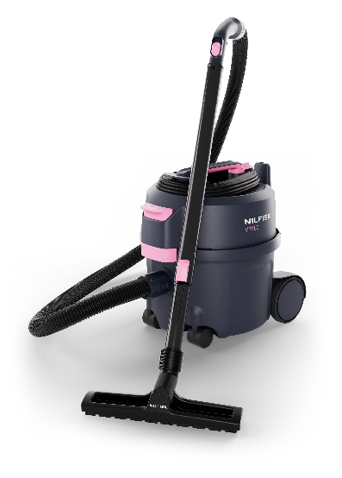
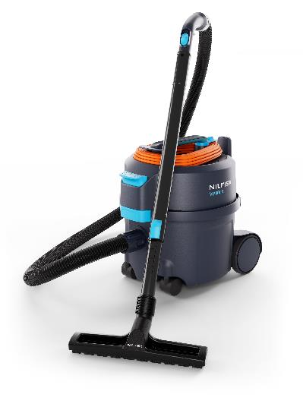
3 | Zoom-in on selected models
Fight cancer (Pink) & RecycledTE
VP300 Pink
Campaign model → X EUR goes to the local-national cancer fighting association
Example from DK – for every sold Pink model, 100DKK is donated
VP300 R
Made out of 38% sustainable PCR plast
The recycled plastic used in 1 VP300 R equals 115 plastic bottles (imagine these floating around in the nature)
Currently we are the only one using PCR on COM VACs (USP in R models)

Slide 27
Agenda
1
Background, Brand & Design & Value proposition
6
Accessories
2
Target segments & Strategy
7
Other
3
New range
4
Key selling points
5
Key competition

Slide 28
4 | VP300 product benefits
Key selling points
New designed Bent-ends Improved ergonomics, grip & durability
Cord storage – 3 options
New smart EOB cord storage ensuring uptime by no mess
Cord quick-release Cord quick-release (turn knob) - immediate start working
Ergonomic machine handle
Comfortably suiting multiple hand sizes & kept tube storage option at ”transport”
Detachable power cord *
No-tool cord exchange with durable locking for time and cost saving
Durable foot-operated power switch Easier and more ergonomic to use
Tube parking
Fast and easy tube parking when needed
Bag & Prefilter access
Easy ergo access to bag & prefilter
High performance dust bags
High net filling capacity prolonging working time
and keeping performance
Certified HEPA filter *
Quick, tool-free checks and replacements,
ensuring optimal air quality while saving time
Low noise level Powerful cleaning with one of the quietest vacuum cleaners
in its class, allowing you to operate without disturbing others
Compact, light-weight design
Easy to transport and reduces strain
* Majority of range

Slide 29
4 | VP400 product benefits
Key selling points
New designed Bent-ends Improved ergonomics, grip & durability
Reliable cord rewind Durable and smooth rewind system eliminates cord issues
Ergonomic machine handle
Ergonomic handle designed for comfort, accommodating smaller hands as well
Detachable power cord
No-tool cord exchange with durable locking for time and cost saving
Durable foot-operated power witch Easier and more ergonomic to use
Tube parking
Fast and easy tube parking when needed
Bag & Prefilter access
Easy ergo access to bag & prefilter
High performance dust bags
High net filling capacity prolonging working time
and keeping performance
Certified HEPA filter *
Quick, tool-free checks and replacements,
ensuring optimal air quality while saving time
Low noise level Powerful cleaning with one of the quietest vacuum cleaners
in its class, allowing you to operate without disturbing others
Compact, light-weight design
Easy to transport and reduces strain
* Majority of range

Slide 30
4 | Highlighted selling points vs positioning
High net filling | Low sound level | Low weight & compact
High net filling capacity
Low noise level compared to positioning
One of the best in class
Saves you money on maintenance (bags and time to change) besides ensures higher performance over time (cleaning more efficient/properly = faster)
Saves time and cost
if practically double bags needed by competitor (VP300 scenario 1 bag used per week)
50 weeks * 1 bag extra at 1EUR per week = 50EUR + 5min additional (change) at hour rate of 15EUR → 50 times*5 = 250min * = 62,5EUR
112,5 EUR/yearly
.
Best-in-class
Sound pressure level at 51 dB(A) in working position of the operator
Takes care of the customer along with reduces disturbance when cleaning in occupied areas
.
Low weight & compact
Easy portability and user friendly
Less operator strain/injuries
Easy storage (small footprint)

Slide 31
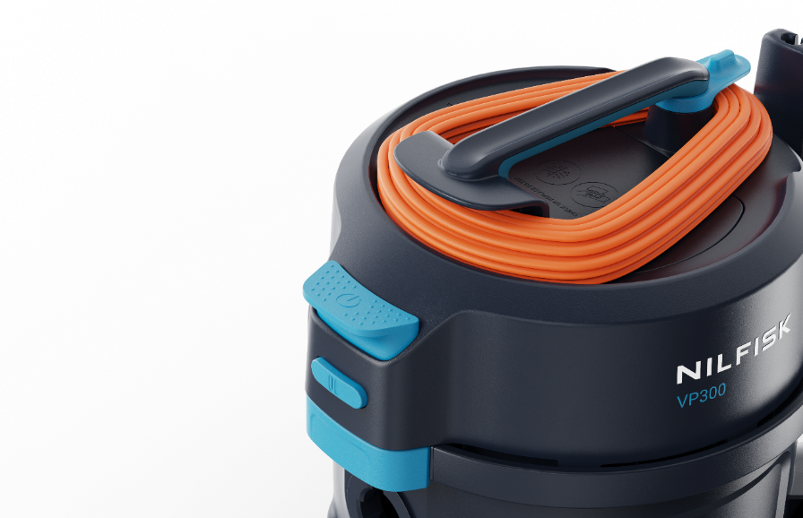
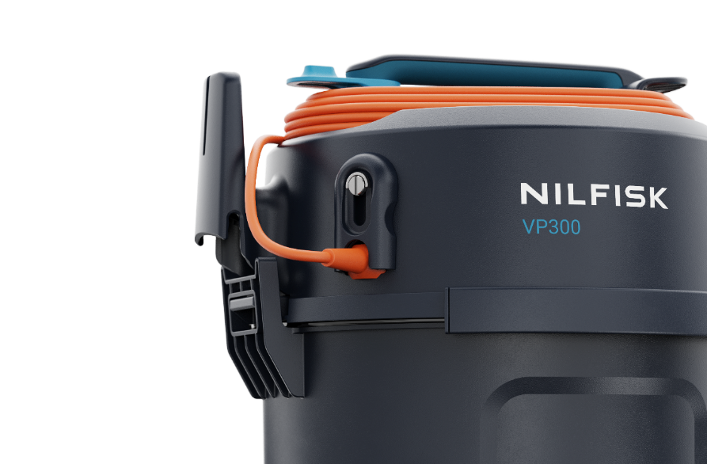
4 | Cord storage VP400
Upgraded cord storage → Now 3 considered ways (flexibility) | Proper EOB spot reduces cord strain/risk of mess
Despite of 2 options on old VP300, customers struggle the most with cord handling and storage
Under handle or free hanging on hook → time consuming due to
High risk of messy/twisted cord (damages) → downtime/cost
Neat placement both for quick storage end of the day
Never a mess = uptime @ save cost/longer cord life (less damage)
Fast start-up every day

Slide 32
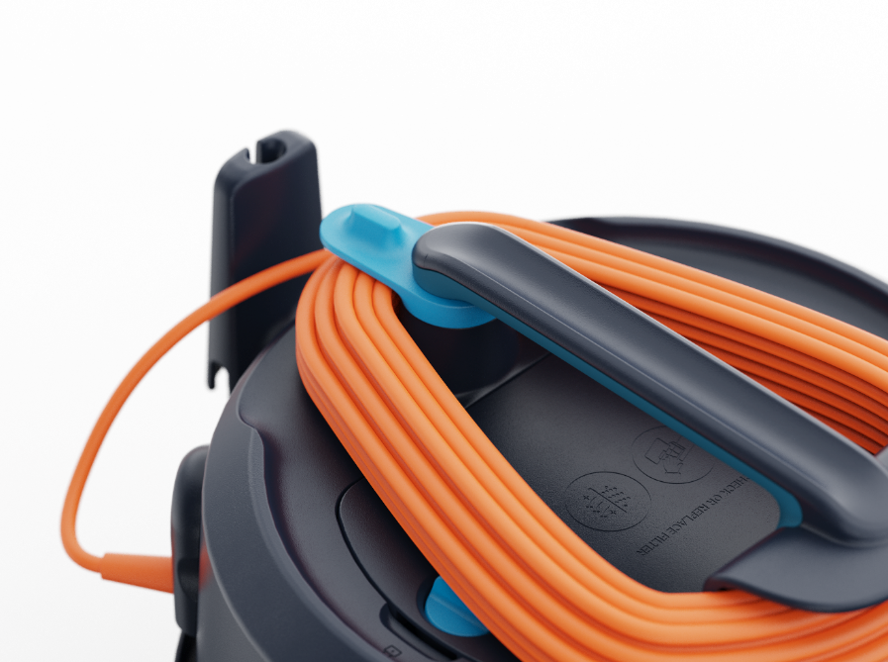
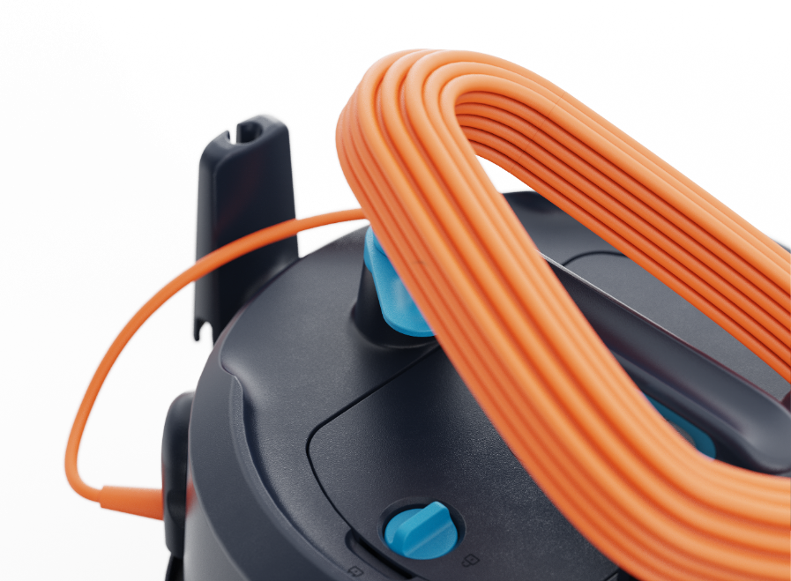
4 | Cord Management VP300
Cord quick-release → (turn knob) immediate start working
Get started right away
Optimise work flow – reduce time waste
Time & cost saving

Slide 33
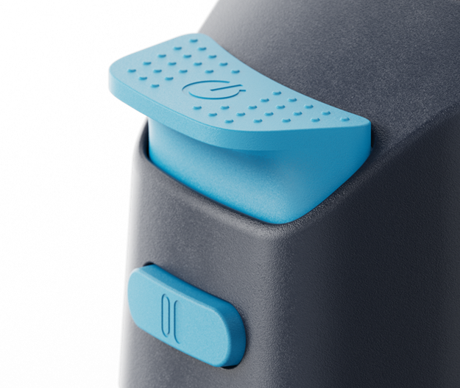
4 | Get the VAC fired up
Durable and large power switch | Possible to operate by foot | Reduced operator strain/injuries
Easy use & operator comfort
Large durable power switch
Separate dual speed button (selected models)
Inmolded icons for better guidance

Slide 34
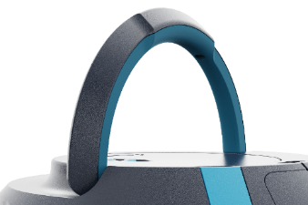
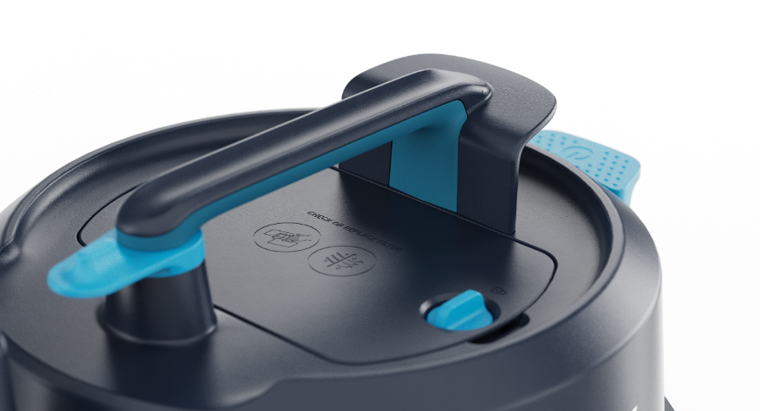
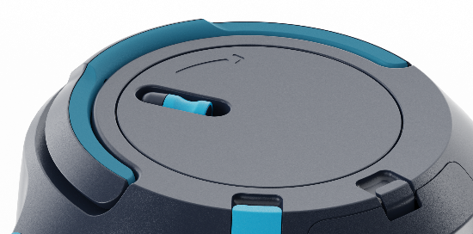
4 | Machine handle Zoom-in
Ergonomic primary touch point | Besides shape, smaller hands considered too (many women in this sector)
Kept possibility for tube ‘storage’ during ”transport”
Less operator strain
VP300
VP400

Slide 35
4 | Bag & Prefilter access
More space & ergo touch
Before
Tight and edgy finger access
Not ergonomic
Now
Enlarged space → more comfortable use, with recess
Front design protecting latch
Easy ergo access to bag & prefilter

Slide 36
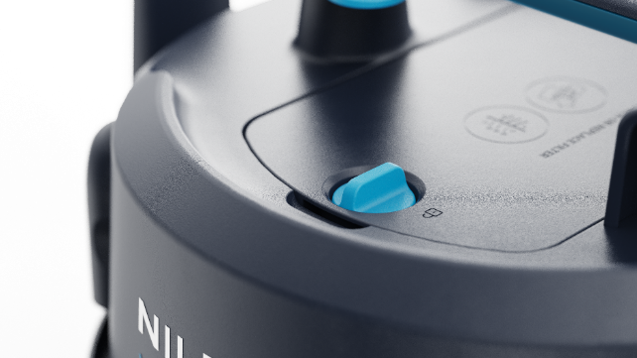
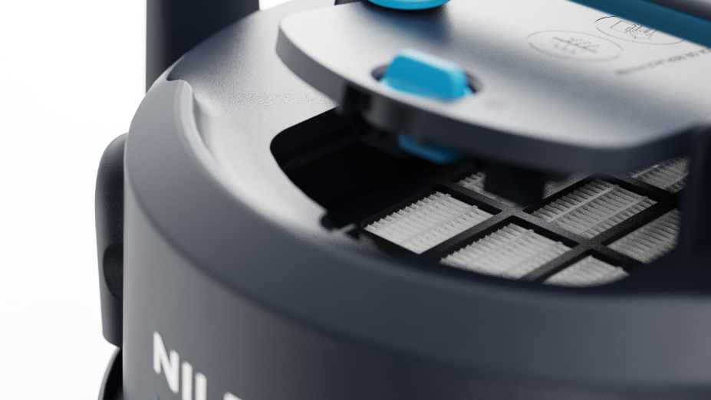
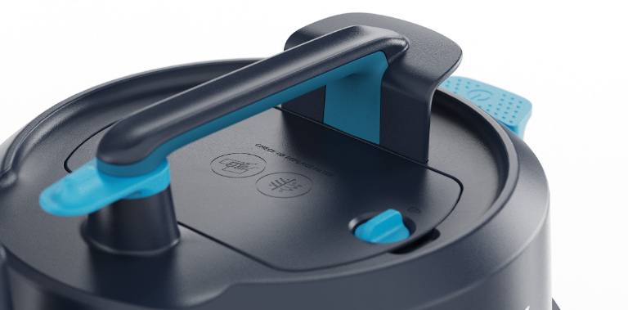
4 | Filtration detail 1 of 3
Main filter guidance & access VP300-400-500 | Icons, Text, Ergonomic knob & finger scoop → immediate access
Old models: 1+6 screws, tools needed & over 3-4 steps
New range: No tools & visuals on main filter door → 1-hand easy-quick filter access for check/replace

Slide 37
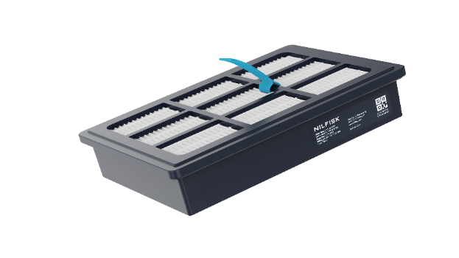
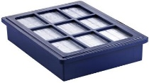
4 | Filtration detail 2 of 3
The HEPA filter | Enhanced serviceability & usability
From 2017 until now (EU models)
Old HEPA filter
No grip/touch point
Tools needed to access and no guidance (1+6 screws) → lack of change, lower life om machine, lower efficiency etc
HEPA filter upgrade
HEPA filter *
Grip point & color-highlighted → optimising usability & time
Ensuring good and healthy air quality (catching small particles – HEPA 13 or 14)
Same interface as earlier (now also fitting GD1000 replacement)
- used for whole Commercial compact vac range
* HEPA configured models only

Slide 38
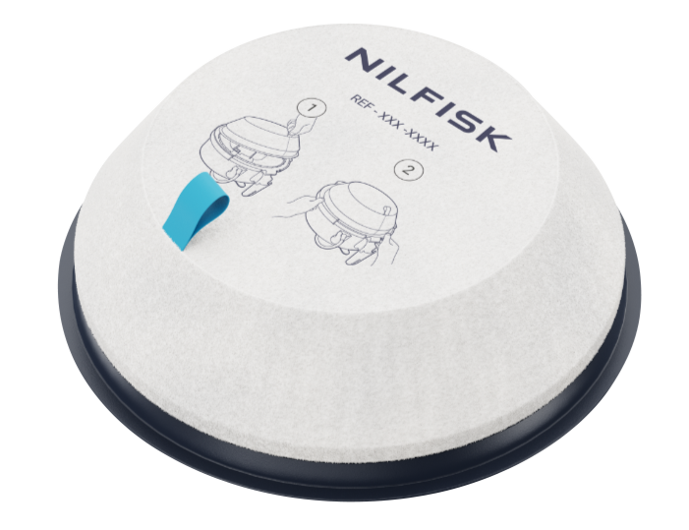
4 | Filtration detail 3 of 3
Prefilter of VP300, 400 & 500
Same prefilter as before across VP300 series, but upgraded:
Now with
PN, illustrations/guidance & highlighted touch point
Improved tolerance/usability (before too tight, difficult to take off)

Slide 39
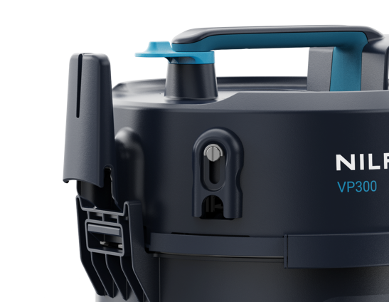
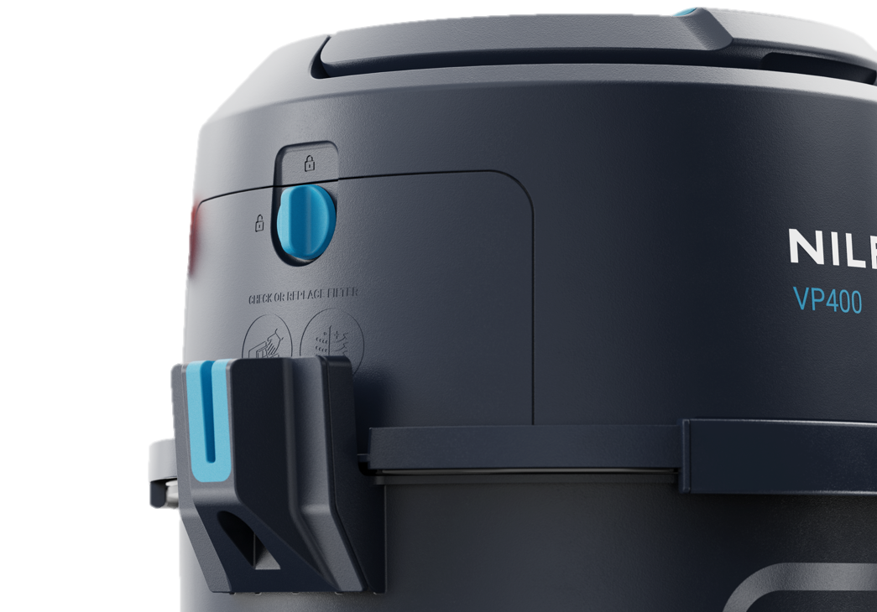
4 | Parking Zoom-in
Neat/safe storage of tube/nozzle | Smaller footprint EOB | Reduce risk of injuries/damage if acc not all-over
VP300 tube parking
VP400 tube parking

Slide 40
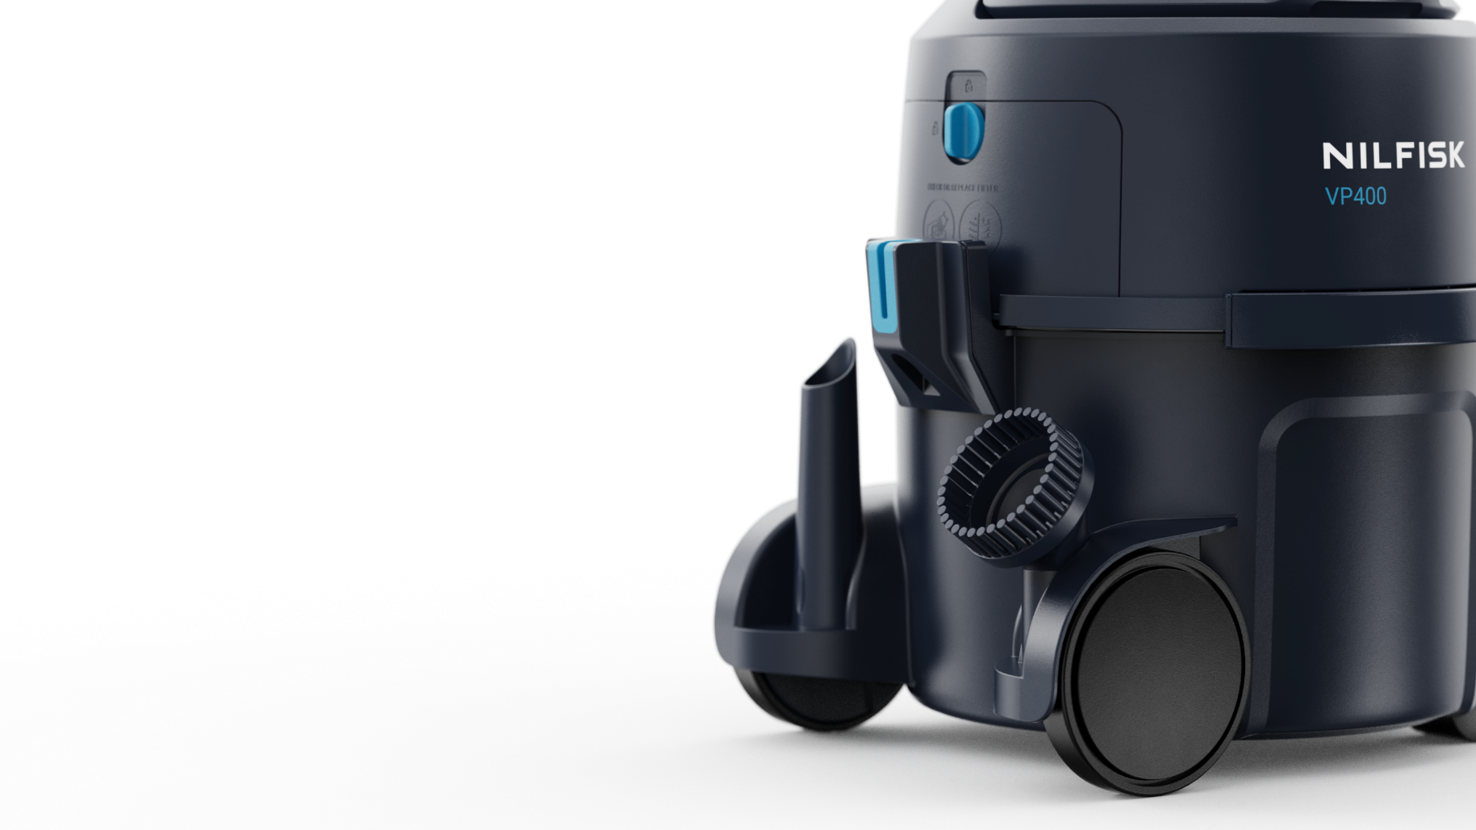
4 | Storage Zoom-in
Small tool storage enhancement → now in-molded structure

Slide 41
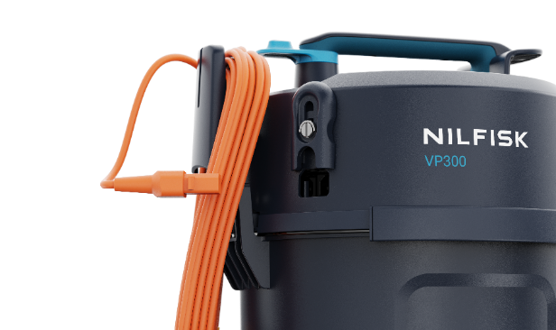
4 | Detachable cord
Improved serviceability and convenience (no tools needed) | 98% of range detachable cord
Entry models
Fixed power cord (black)
Larger strain on cord, reducing life
Replacement/service: Time consuming and costly (workshop)
Detachable cord models → Ease of use/service
Detachable cord rewind system
NEW → No tools needed
Fast to replace if broken/damaged by operator “on the fly”
Possible to remove and undo potential messy cord
Orange → increase safety esp. at daytime cleaning with people walking around (Hotels, schools, hospitals etc)
Note: VP400 std. detachable cord (also no tools & FAST) → USP vs competition

Slide 42
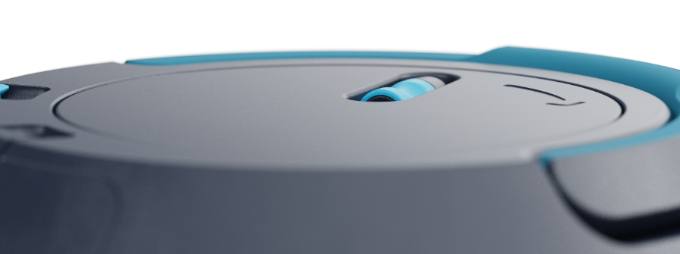
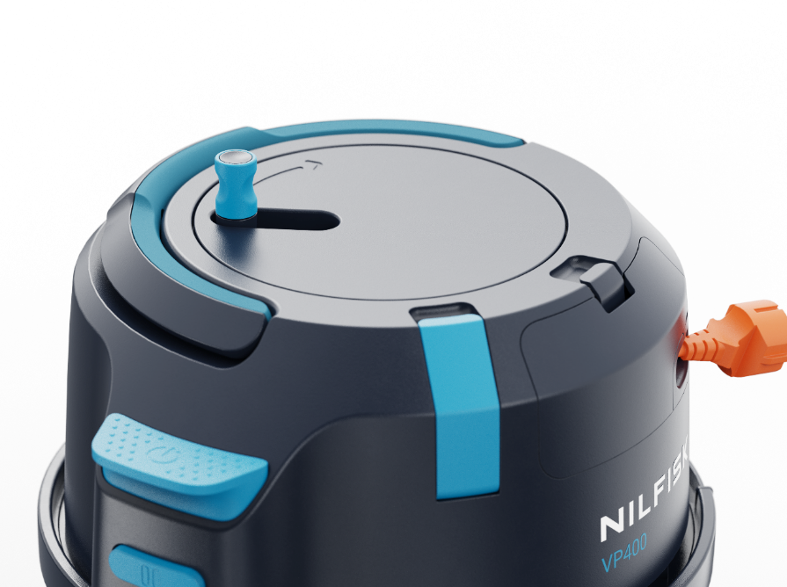
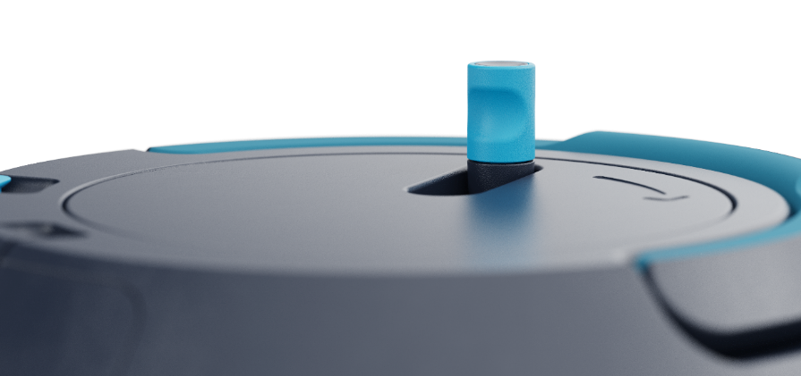
4 | VP400 rewind zoom-in
Patent pending functionality (enables ‘no twisting/mess’) | Guidance & Ergo knob | Rewind EOL repair possible

Slide 43
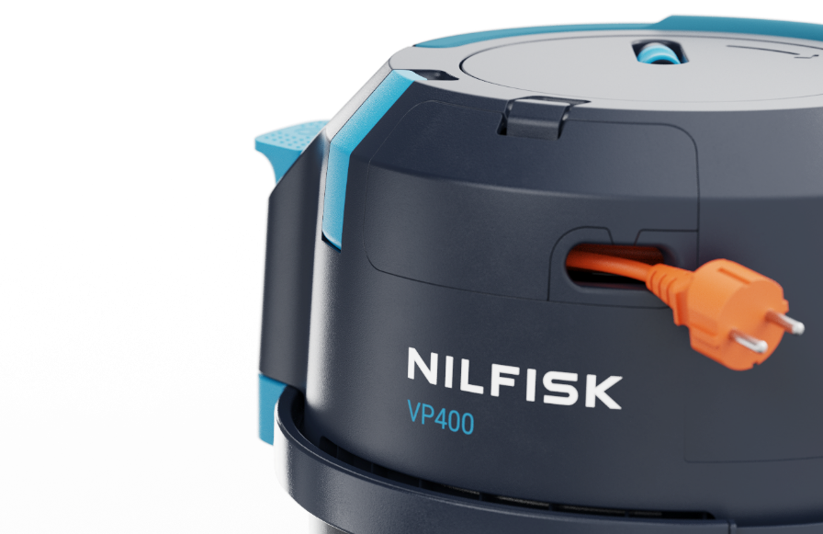
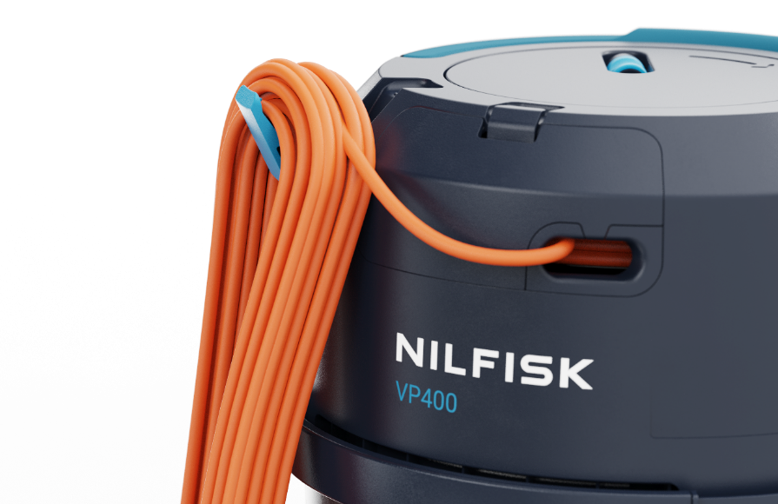
4 | VP400 Cord hook
Quick parking/storage when changing working area or quickly need to do other task –other building, room etc
Save time, but protect/have cord in place without need for rewind and pull-out full length again when ready to start
Access to cord replacement through ‘service’ door
No tools needed

Slide 44
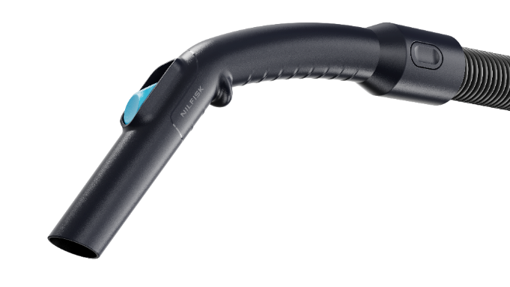
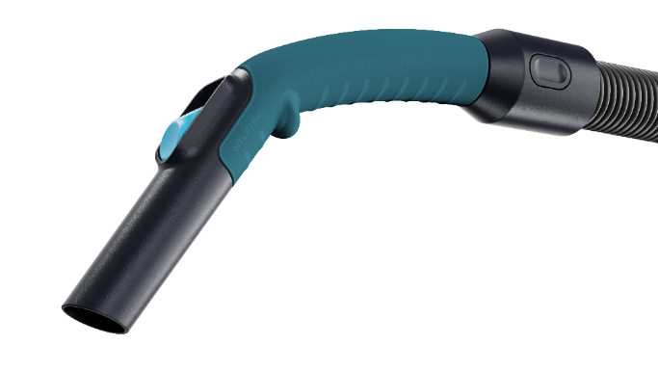
4 | Accessory upgrade
New designed Bent-ends | Improved ergonomics, grip & durability | Less operator strain
Basic
Premium
vs old Bent-end
Feature | Old bent-end | New bent-ends
Suction control slider | • | •
Lightweight | • | •
Highlighted touchpoints |  | •
Ergonomic angle considered |  | •
Reduced blocking smooth curve |  | •
Protected suction regulation |  | •
Easy replacement of hose (Click connection) |  | •
2K grip texture* |  | •
Highlighted grip point* |  | •
*Only premium version

Slide 45
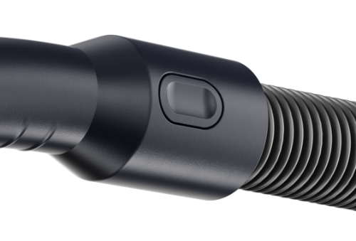
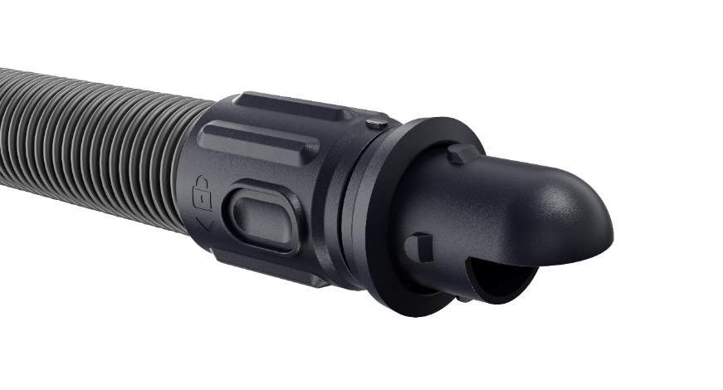
4 | Accessory upgrade
New customer friendly hose connectors | Enhanced usability and serviceability
If hose needs to be renewed – easy to do swap with quick-click system (no tools)
Sealings and hose connection optimized → improved performance
”Tap” pointing upwards for optimal installation at machine inlet

Slide 46
4 | VP300 Summary
Old vs New (upgrade colored area)
Feature | VP300 | VP300 (New)
Machine bumper | • | •
Lightweight | • | •
Tube parking position | • | •
HEPA filter | • | •
Accessories storage | • | •
Good functioning container lock system | • | •
Highlighted touchpoints |  | •
No-tool HEPA Filter access |  | •
Protected lock mechanism |  | •
Detachable cord standard on most models |  | •
Robust foot operatable power switch |  | •
Ergonomic handle + Ergo latch |  | •
Improved accessory storage |  | •
Improved cord storage/management (time optimize) |  | •
Quick-release cord management |  | •
Easier prefilter removal |  | •
VP300
VP300 (New)

Slide 47
4 | VP400 Summary
Old vs New (upgrade colored area)
Feature | VP600 | VP400 (New)
Machine bumper | • | •
Robust foot operatable power switch | • | •
Tube parking position | • | •
HEPA filter | • | •
Accessories storage | • | •
Highlighted touchpoints |  | •
No-tool HEPA Filter access |  | •
Protected lock mechanism |  | •
Detachable cord standard |  | •
Reliable and durable rewind system |  | •
Lightweight & Compact footprint |  | •
Ergonomic foldable handle |  | •
Improved accessory storage |  | •
Cord hook for quick park/shift of location |  | •
VP600
VP400 (New)

Slide 48
4 | Nilfisk models vs Customer application
For internal use only
How well does it do the job?
Daily operation/cleaning task (JTBD)
Cleaning (dust & debris) | Quick-“no-tool” filter change | Fast & “no-tool” power cord change | Seamless EOB cord storage | Cord storage flexibility | Immediate start working (cord out) | Silent operation (school, office..)
Values
Daily comfort | Convenience (cord management) | Maintenance
Vac model (selected archetypes)
VP300 HEPA Basic
VP300 HEPA
VP300 HEPA S2
VP400 HEPA
Legend
0/4 suitable
1/4 suitable
2/4 suitable
3/4 suitable
4/4 suitable

Slide 49
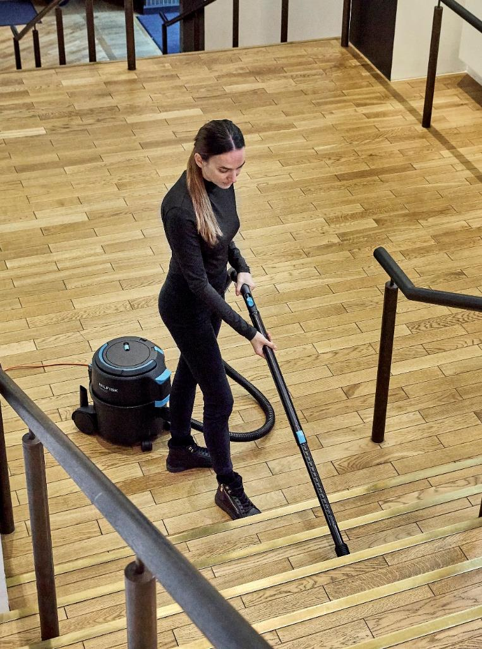
Agenda
1
Background, Brand & Design & Value proposition
6
Accessories
2
Target segments & Strategy
7
Other
3
New range
4
Key selling points
5
Key competition

Slide 50
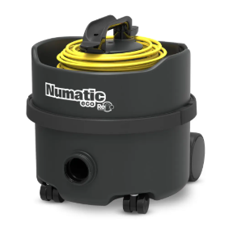
VP300 vs ERP180
Reasons to buy Nilfisk over Numatic:
Lower sound level despite of higher suction power
Higher net filling capacity vs Numatic 170’s/180s
Ergonomic shaped machine handle → less strain
More ergonmic bent-end (primary touch point)
Durable large (easier use) power switch
HEPA standard on majority of Nilfisk VP300 models
Bayonet hose connection with rubber sealing (faster, secure & smooth)
Coloured UI
For internal use only
Head-to-head – Entry level
Nilfisk VP300
Performance: 700W (EU)
Net filling: 6.5L
UX: Ergo touch points
Numatic ERP180 or PRP180
Performance: 420W or 620W
Net filling: 3.5L
UX: Non-ergo touch points

Slide 51
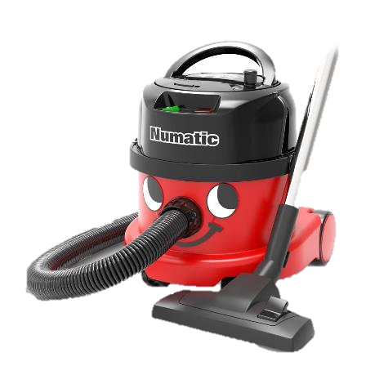
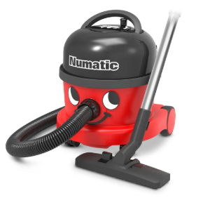
VP400 vs PPR170/240
Reasons to buy Nilfisk over Numatic:
Easier ”No-tool” cord replacement
Lower sound level despite of higher suction power
VP400 rewind better quality feeling
Ergonomic shaped machine handle → less strain
Durable large (easier use) power switch
Bayonet hose connection with rubber sealing (faster, secure & smooth)
HEPA standard on majority of Nilfisk VP300 models
Higher net filling capacity (dep. on Numatic model size → but if same; trade off size & weight)
Coloured UI
For internal use only
Head-to-head – Entry level
Nilfisk V400
Performance: 700W (EU)
Net filling: 6.5L
Weight: 5.5 - 6kg
UX: Ergo touch points
Numatic PPR170 or NRV240
Performance: 620W
Net filling: 3L / 6L
Weight: 7kg
UX: Non-ergo touch points

Slide 52
5 | VP300 Match-ups
For internal use only
Selected key competitors | Why not competitor vs Nilfisk VP300?
Numatic/Nupro ERP180 or PRP180
Lower net filling: 3.5L
Non-ergonomic handle
Container access 2-step operation = more time (vs 1 step)
Only 1 cord storage option (vs VP300 triple)
Often non-HEPA models present
Numatic PPR170
Lower net filling: 3.5L
Non-ergonomic handle
Container access 2-step operation = more time (vs 1 step)
Rocker power switch less ergonomic/user friendly (vs large durable push button)
Rewind → Takes longer time before start-up (VP300 Cord quick-release)
Often non-HEPA models present
Kärcher T10/1 or T11/1 Classic
Extreme low net filling: ONLY 1.8 → 3x more bags needed (if 1p/week of VP300 = 50) → Kärcher 150 - delta: 100*1EUR = +100 EUR/y
Non-ergonomic handle
Container access 2-step operation = more time (vs 1 step)
Bad and only 1 cord storage option (vs VP300 triple)
Time consuming start up with this storage option (vs 3 options and cord-quick release → immediate start)
IPC LP 1/12
Lower net filling: 2-3L
Non-ergonomic handle
Less suction power
Short power cord
Low quality feeling
Note: Reflo version (Recycled) with smaller motor and much lower performance; 450W
Note: PPR240 version has comparable net filling (6-6,5L), but taller than VP400

Slide 53
5 | VP400 Match-up
For internal use only
Selected key competitors | Why not competitor vs Nilfisk VP400?
Numatic PPR or NRV/VNR
Lower net filling: 3.5L
Lower suction power & higher noise
Not same quality/ functional perception and use as VP400
Non-ergonomic handle
Container access 2-step operation = more time (vs 1 step)
Rocker power switch less ergonomic/user friendly (vs large durable push button)
Often non-HEPA models present
Only 12.5m cord
Taski AERO 8 Plus
Only 3L net filling
Lower suction power & higher noise
More difficult to exchange cord
Heavier; 7.5kg
Can tangle/get stuck power cord
Non-ergonomic handle
Often non-HEPA models present
Often only 12m cord
Sprintus ERA EVO/TEC
Smaller net filling: 5L
Lower suction power & higher noise
More difficult to exchange cord
More easily get tangled/stuck power cord (worst) - rewind not running seamless
Non-ergonomic handle
Often only 12m cord
Fragile hose connection
Hako Supervac Proff 1.2
Net filling only 4.8L
Lower suction power & higher noise
More difficult to exchange cord
Heavier; 7.5kg
Uses 2.1 rounds per meter (other around 1.7-1.8)
Quite similar rewind quality/functionality vs VP400, but higher price point
14m cord (vs 15m)
Flimsy latch
HEPA replace; screws/tool
Note: Taski 15 only 4L net filling

Slide 54
6 | Competitor Overview
For internal use only
Tech Specifications*
Features |  | VP300 / VP400 (New - EU) | Numatic ERP180 & PRP180 | Numatic PSP180/240 | Kärcher T10/1 | Kärcher T11/1 | Kärcher T12/1 | Sprintus Ares | Sprintus Floory | IPC LP 1/12 | iVac 6 | Numatic PPR170/240 | Taski AERO 8 PLUS | Sprintus ERA EVO/TEC | HAKO Supervac
Rated power | W | 700 | 420 or 620 | 620 | 700 | 900 | 700 | 700 | 700 | 900 | 850 | 620 | 585 | 700 | 900
Gross capacity/size claim | L | 10 | 8 | 8 / 10 | 10 | 11 | 12 | 7,5/10 | 7/11 | 12 | 6 | 8 / 10 | 8/13 | 9/13 | 10
Net filling (Test) | L | 6.5 | 3.6 | 3.6 / 6.4 | 1.8 | 1.9 | 2.6 | - | - | 3.3 | TBD | 3.6 / 6.4 | 3 | 5.5 | 4.8
Net filling ratio (net vs claim) |  | 0.65 | 0.45 | 0.45 / 0.64 | 0.18 | 0.17 | 0.21 | - | - | 0.27 | - | 0.45 / 0.64 | 0.37/0.23 | 0.61/0.42 | 0.48
Main filter surface size & type (smallest = 1) |  | 3: HEPA on most | Std. | Std. | 1: Std (HEPA opt) | 1: Std (HEPA opt) | 1: Std (HEPA opt) | Std. | Std. | Std. | 2: Std (HEPA opt) | 2.5: Std (HEPA opt) | 2.5: Std (HEPA opt) | 1: Std (HEPA opt) | 3:; HEPA
Airflow*** | l/s | 32 | xx & 48 (26 & 30) | 48 (29) | 43 (32) | 40 (29) | 43 (30) | - | - | 43 (27) | 50 | 48 (31) | 33 (28) | (26) | (28.5)
Vacuum*** | kPa | 22 | 17 & 22.5 (15 & 17.5) | 22.5 (17.5) | 22 (22) | 23.5 (22) | 22 (22) | - | - | 22 (17.5) | 21 | 22.5 (18) | - (16.5) | (22) | 27 (22.5)
Suction power ‘end tube’ | W | 225 | 130 & 165 | 165 | 225 | 190 | 200 | - | - | 140 | - | 170 | 165 | 180 | 185
Efficiency (suction pwr vs rated) | % | 32% | 30% & 26% | 26% | 32% | 21% | 28% | - | - | 15% | - | 27% | 28% | 25% | 20%
Sound pressure level** | dB | 56 | - | - | - | - | - | - | - | - | - | - | - | - | -
Sound power level** | dB | 69 | 70 & 73 | 73 | 77 | 76 | 78-80 | 78 | 77 | 79 | - | 73.5 | 63 | 75 | 67 (76.5)
Cord length | M | 10-15 | 10 | 10 | 12 | 7.5 | 12-15 | 8 | 10 | 8.5 | 15 | 10 | 12.5 | 10/12 | 14.5
Dimensions (LxWxH) | mm | 398x340x395 | 340x365x360 | 340x365x360 /360x370x415 | 355x310x410 | 385x285x385 | 410x315x340 | 340x330x315 | 350x290x380 | 400x400x330 | 390x380x360 | 340x365x360 /360x370x415 | 595x395x425 | 380x280x430
Weight (machine) | Kg | 4.5 / 5.8 | 5 | 5 | 6.3 | 4.2 | 6.4 | 4.2 | 4.2 | 5.8 | 6.8 | 7 | 7.5 | 5.1-6 | 7.5
* Test data (blue marking) will always have tolerances (averages) – can only be used as guidance ** Sound tested according to standards of Commercial Vacs (Machine directive)
*** Performance data of tested machines → end of tube (incl accessories)

Slide 55
6 | Competitor Overview
For internal use only
Features/UX
 | VP300 & VP400 (New - EU) | Numatic ERP180 or PRP180 | Numatic PSP180/240 | Kärcher T10/1 | Kärcher T11/1 | Kärcher T12/1 | Sprintus Ares | Sprintus Floory | IPC LP 12 | iVac 6 | Numatic PPR170/240 | Taski AERO 8 PLUS | Sprintus ERA EVO/TEC | HAKO Supervac
Speed mode | ✓* | × | × | × | × | ✓* | × | × | × | ✓ | ✓* | ✓ | ✓ | ✓
Machine handle ergo level (1-5) | 5 | 2.5 | 2.5 | 2 | 2 | 2 | 1 | 2.5 | 2 | 3 | 2 | 3 | 2.5 | 3.5
Power switch type & Ergo level (1-5) | Push 4 | Rocker 1 | Rocker 1 | Push 3 | Push 1 | Push 3 | Push 3.5 | Push 4 | Push 1 | Rocker 1 | Rocker 1 | Push 3 | Push 3 | Push 5
Cord type | Detach* (No tool) | Detach | Detach | Detach (tool) | Fixed | Detach (tool) | Fixed | Detach (tool) | Fixed | Detach | Detach* | Detach (tool) | Detach (tool) | Detach (tool)
Cord storage | ✓ (VP300 Triple; best EOB + quick release) | ✓ (Single + quick release) | ✓ (Single + quick release) | ✓ Single; top @ not user-friendly | ✓ Single; hook | ✓ Single; top @ not user-friendly | ✓ Single; hook | ✓ Single; hook | ✓ Single; top @ not user-friendly | ✓ Single; hook | Rewind | Rewind | Rewind | Rewind
Accessory storage | ✓ | ✓ | ✓ | ✓ | × | × | × | ✓ | × | × | ✓ | ×* | ✓ | ×
Recycled information | Selected; PCR as only → USP | ERP180; min 45% claim | NA | NA | 60% claim | NA | NA | Floory Zero; 75% claim | Up to 75% claim | NA | EPR170; min 20% claim | NA | PRO model variant with recy % | NA
Other | Valve (when bag filled/clogged system) |  |  |  |  |  |  |  |  | Valve + sound when full bag & Hose +strength |  | Filter dust bag indicator* + Power socket | PRO model with BT
* Depend on model – Detach cord; Nilfisk majority of range (most VP300, all VP400)

Slide 56
6 | Key selected competition
For internal use only
Market price positioning*
100€
150€
200€
250€
Nilfisk VP300
Kärcher T 12/1
Kärcher T 11/1
Kärcher T 10/1
iVac 6
Numatic ERP180
Nilfisk VP300
Numatic PSP/JVP/NVP180/240
Sprintus Floory/Ares
IPC/Soteco LP1/12
Nilfisk VP400 (Rewind)
Numatic PPR170/240
Hako Supervac
Taski Aero 8 PLUS
Nilfisk VP400 (Rewind)
Sprintus ERA EVO
* Global dealer-list span ex VAT (dep. on model, config & country – e.g. UK lower priced) - can be used only as indication/guidance (varies a lot) → target is to try beat Numatic where reasonable price still locally = eat m-shares

Slide 57
5 | Value selling – Improved UX & UI
For internal use only
Saved time and resources (cost) on cleaning vs competition
Customer benefit
Improved cleaning efficiency (cord handling and suction)
Improved ergonomic increases the operator comfort – main grip points with right sizes, shapes, space, and angles.
Intuitive operation (highlighted areas at primary interaction)
Easy to maintain – No-tool quick exchange of filters (USP) and cord*
Easy to clean – wipeable surfaces, good clearance for hard-to-reach areas
Customer value
Saved time of your staff on cleaning jobs – same quality of job done faster
Saved time on machine maintenance and cleaning
Value quantification
Vacuuming and machine maintenance:
60 mins. spent every day on vacuuming + 5-10 mins. spent everyday machine maintenance (check/replace bags or filters, re-tangling twisted cord (e.g. if not stored a good place) easy use of the machine)
3 minutes saved daily due to better performance, UX+UI and easier maintenance.
Saved 3 mins x 15 €/hr salary of an operator x 320 days = 240 €/year
Other options:
Energy saving could be another calculation – or rewind vs manual cord
– or net filling impact on yearly bag cost
* detachable cord on all VP400 (most VP300)

Slide 58
Agenda
1
Background, Brand & Design & Value proposition
6
Accessories
2
Target segments & Strategy
7
Other
3
New range
4
Key selling points
5
Key competition

Slide 59
6 | PAC overview
Selected items
Highlighted key items
HEPA filters HEPA 13 147 1250 600
HEPA 14 107421443
Dust bags
Paper 5pcs 82367810
Paper 10pcs 140 8618 000
Fleece bag 10pcs 82367820
Reuseable bag 1pcs 22251800
New VP300 family maintenance kits
Light (5 bags, 1 HEPA, 1 motor filter) 107421454
Plus (20 bags, 1 HEPA, 1 motor filter) 107421455
Multi surface nozzle 140 6700 540
Combi nozzle RD295P 107417790
Other
2m Hose CPL. W bent-end 107421450
2m Hose CPL. W bent-end PREM 107421451
2m Hose antistatic cpl bent-end 107415116*
Hose W connectors 107421449
Ext. tube steel (2pcs) 140 8246 040
Ext tube alu - black (2pcs) 107421471 (new PN)
Telescopic tube alu – black/blue 107421463 (new PN)
Wider premium HF nozzle (350mm) 107413080 (495mm 107413081)
Crevice 147 0146 500
(hard; 010 3098 500)
Radiator crevice (245mm) 81530400 (brush; 010 5818 140)
* Old bent-end; awaiting update with new bent-end w connectors

Slide 60
6 | Other PAC
Selected items for new VP300 & VP400
Detachable cord 10m EU, orange | 559505160
Detachable cord 15m EU, orange | 559505161
Detachable cord 10m CH, orange | 559505165
Detachable cord 10m UK, orange | 559505162
Detachable cord 15m UK, orange | 559505173
Detachable cord 10m AU/NZ, orange | 559505167
Detachable cord 15m AU/NZ, orange | 559505175
Detachable cord 15m CN, orange | 559505169
Detachable cord 10m US, orange | 559505164
Detachable cord 10,5m ZA, orange | 559505171
Fixed cord 10m EU, black | 559505163
Fixed cord 15m JP, black | 559505166
Numatic adaptor (20 pcs.) | 107401199

Slide 61
Agenda
1
Background, Brand & Design & Value proposition
6
Accessories
2
Target segments & Strategy
7
Other
3
New range
4
Key selling points
5
Key competition

Slide 62
7 | New customer focused feature
QR tag on full new range
QR tag on the typeplate
Fast access to…:
Product data/information
Accessory overview
Manuals
etc
Scan QR code on the type plate
and you get to the landing page of the product on the website right away

Slide 63
7 | New packaging details – VP300
New design (old just saying “Nilfisk”) | Configuration illustrations on box label too

Slide 64
7 | New packaging details – VP400
New design (old just saying “Nilfisk”) | Configuration illustrations on box label too

Slide 65
7 | Co-branding & Private label
For internal use only
Option details & Process
Option 1: Branding silk-print
From production – requires new end-item creation
Qty if DC stock-item: +1000/y (only initial ref – if part-colour change, higher needed)
If direct ship to customer: min. 1 container/y
Option 2: Branding label
Add local – SC or customer
Label kit configuration(s) - examples: - 50pcs - 200pcs - 500pcs
Shipment details to be agreed - Direct to customer or SC
Process to both options
CPM reach out to GPM, including following:
Co-branded model (example)
VP300 & ICE Cleaning
1
MSS file with details on change/modification wish; l) Spec/config ll) Sales qty Y1, Y2 & Y3 lll) Net price expectation
2
GPM evaluate BC & investigate with RD
OPT 1; if ok level, move to next step (generate PN etc)
OPT 2; align on - label kit pcs + yearly forecast - shipping detail
3
Share print file of logo (PDF & ai-format) with below details:
Colour details (RAL or Pantone code)
For label: size wish (LxWxH) → to be clarified if possible
Sample for approval to be made

Slide 66
VP300 & VP400
Simple & Reliable

