Slide 1
Compact Dry Vacuums
Sales presentation

Slide 2
Key messaging
Introducing the new Compact Dry Vacuum range
A new formula for simplicity

Slide 3
Compact Dry Vacuum
A new formula for simplicity
Introducing the new Nilfisk VP300 and VP400 — Commercial dry vacuums targeted for the entry-level area and designed for delivering best-in-class performance across key parameters.
VP300: An enhanced version of the trusted VP300 model.
VP400: A durable new addition featuring a convenient cord rewind system, expanding the product range.
Both models are thoughtfully engineered with the operator in mind:
Compact & lightweight for effortless handling.
High versatility to adapt to specific customer needs.
Reliability for multiple hours of daily use, delivering consistent high performance.
A user-friendly interface, ensuring intuitive operation even for first-time users.
The VP300 and VP400 combine power and convenience in a small footprint, making them ideal for professionals seeking efficient and reliable cleaning solutions.

Slide 4
2
Primary application and use

Slide 5
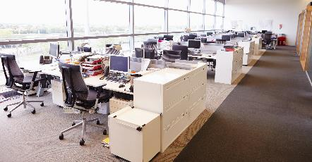
Target segments
Primary customers | CC&I
Contract Cleaners
Institutions
Hospitality
Public administration and offices
Education
Health care
Retail

Slide 6
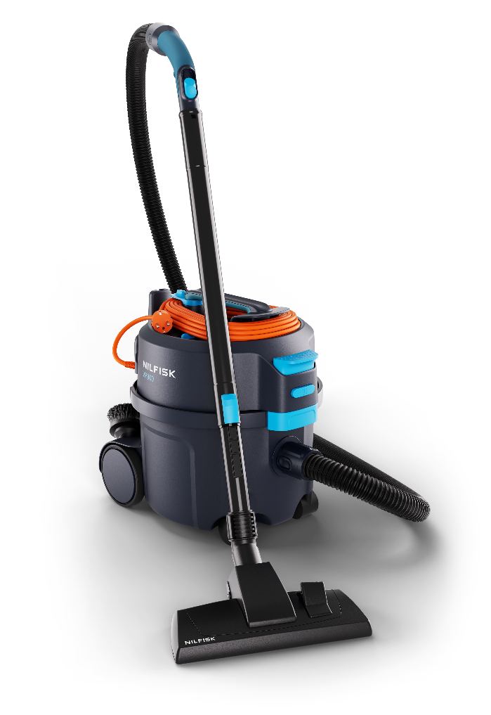
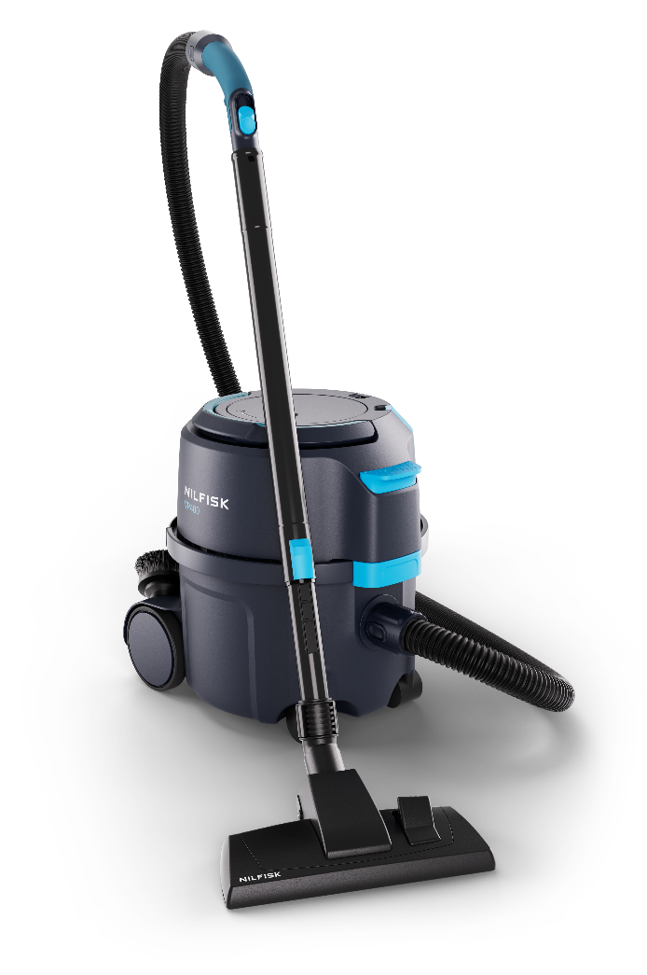
VP300 & VP400 at a glance
VP300 – an improved success
Compact & Lightweight
Reliable
Simple – High productivity
VP400 – new (and best) in class
Efficient
Durable rewind
No struggle – Save time and cost
VP300 excels with its new, vibrant, next-generation design. The lightweight design features improved ergonomics on the handle, lock, and bent end, reducing strain. It also has best-in-class filling capacity and seamless cord management. Furthermore, its quiet operation expands cleaning hours.
The VP400 excels with outstanding performance and convenience, packed into a compact dry vacuum for time-saving productivity. A top feature is its smooth cord rewind, eliminating the risk of time-consuming cord mess. Combined with the foot-reachable power switch, it ensures seamless transitions to other areas.

Slide 7
Key applications and jobs to be done
Daily cleaning: Efficiently clean high-traffic areas like office spaces, hotel rooms and retail stores with the lightweight and portable design.
Tight Space Cleaning: Compact size and manoeuvrability make them ideal for cleaning under desks, furniture, or tight corners.
Long Shifts: Durable construction supports extended use, for cleaning teams working multiple hours daily without performance degradation.
Cord Management: The VP400’s durable rewind system ensures easy cable storage and reduces setup/teardown time during daily operations.
Intuitivity: Intuitive interface for easy operation, even by first time users.
Multi-surface adaptability: Versatile performance suits a variety of surfaces, from carpets in hotel rooms to hard floors in lobbies or kitchens.
Low Maintenance: Reliable with easy filter changes to reduce downtime.
Quiet Operation: Ideal for noise-sensitive environments.
Images are preliminary and may differ from final product

Slide 8
3
Key features, benefits and applications

Slide 9
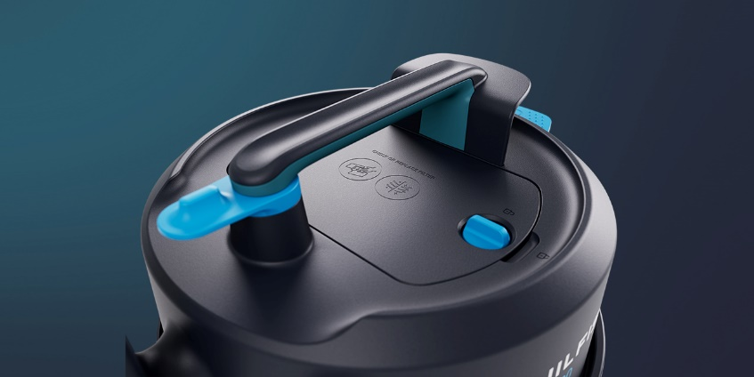
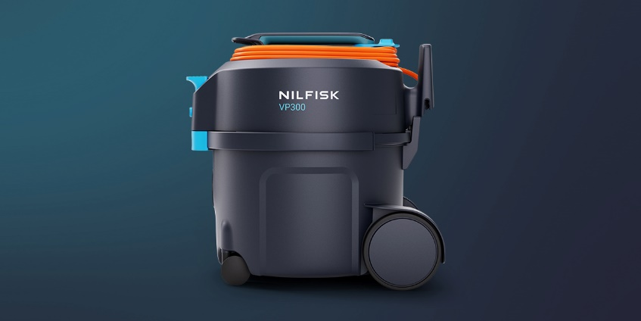
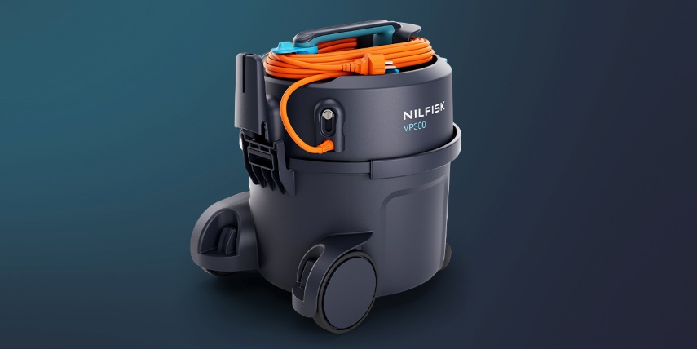
Key values and benefits
A new formula for simplicity
For cleaning, the VP300 and VP400 are compact, high-performing machines. Improved ergonomics and a lightweight design helps to reduce strain and complies with strict health and safety requirements, elevating working conditions.
Simple and intuitive
Designed for seamless operation, our product offers intuitive touchpoints, easy bag replacement for hassle-free maintenance, and user-friendly features like a foot-operated power switch and convenient cord management. These ensure effortless use, smooth task transitions, and enable efficient, uninterrupted work every day. ​
Powerful and productive
Engineered for superior performance, this range delivers a deep clean with fewer passes. Its best-in-class net-filling capacity minimises bag changes and saves costs. Compact and agile, it excels in tight spaces, and its quiet operation ensures cleaning can be done anytime without disruption.
Convenience at your feet
Designed for ease and efficiency, our lightweight, ergonomic vacuum reduces strain and is easy to transport. Intuitive touch points and tool-free access simplify bag and filter maintenance, with easy-to-replace prefilters and HEPA filters ensuring optimal air quality while saving time. Versatile attachments are conveniently stored on the machine, keeping everything within reach for efficient, adaptable cleaning.

Slide 10
Key features and design
VP300
New designed Bent-ends Improved ergonomics, grip & durability
Cord storage – 3 options
New smart EOB cord storage ensuring uptime by no mess
Cord quick-release Cord quick-release (turn knob) immediate start of working
Ergonomic machine handle
Kept possibility to tube storage during ”transport”
Detachable power cord *
No-tool cord exchange with durable locking for time and cost saving
* Most VP300’s, all VP400
Durable foot-operated power switch Easier and more ergonomic to use
Tube parking
Fast and easy tube parking when needed
Bag & Prefilter access
Easy ergo access to bag & prefilter
High performance dust bags
High net filling capacity prolonging working time
and keeping performance
Certified HEPA filter
Quick, tool-free checks and replacements,
ensuring optimal air quality while saving time
Low noise level Powerful cleaning with one of the quietest vacuum cleaners
in its class, allowing you to operate without disturbing others
Compact, light-weight design
Easy to transport and reduces strain

Slide 11
Key features and design
VP400
New designed Bent-ends Improved ergonomics, grip & durability
Reliable cord rewind Durable and smooth rewind system eliminates cord issues
Ergonomic machine handle
Ergonomic handle designed for comfort, accommodating smaller hands as well.
Detachable power cord *
No-tool cord exchange with durable locking for time and cost saving
* Most VP300’s, all VP400
Durable foot-operated powers witch Easier and more ergonomic to use
Tube parking
Fast and easy tube parking when needed
Bag & Prefilter access
Easy ergo access to bag & prefilter
High performance dust bags
High net filling capacity prolonging working time
and keeping performance
Certified HEPA filter
Quick, tool-free checks and replacements,
ensuring optimal air quality while saving time
Low noise level Powerful cleaning with one of the quietest vacuum cleaners
in its class, allowing you to operate without disturbing others
Compact, light-weight design
Easy to transport and reduces strain

Slide 12
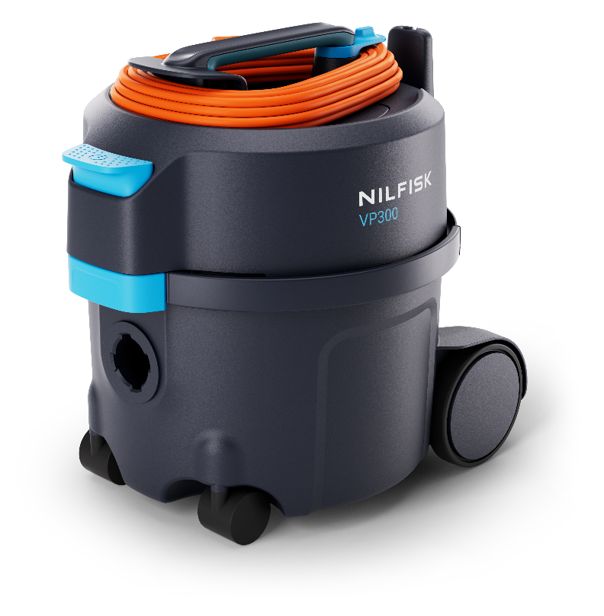
New range upgrades
VP300 & VP400
Improved serviceability
Filter; easy access/no tools
Detachable cord on majority of range*
Performance/Efficiency/Durability
Improved performance +10%, whilst also reducing energy consumption by -12,5%
Best in class sound level — Reduced 3-4dB
New rewind tested to outlive VAC life**
Enhanced UX/Convenience
New VP300 similar weight & size as old
Highlighted touch points
Ergonomic shaped touch points (Handle, bent-end, latch)
Multiple cord storage options (triple on VP300)
Cord Quick-release (VP300; fast start up every day)
Durable large power switch
Icon & illustration guidance
Easy hose repair/replacement
Modernised design
Keeping ref to old despite new design and branding
Improved packaging content (selling points)
Service/maintenance kits
Light (5x bags, 1x HEPA, 1x Motor filter)
Plus (20x bags, 1x HEPA, 1x Motor filter)
398 mm / 15.66 in
340 mm / 13.38 in
395 mm /
15.55 in
* All VP400 models, most VP300
** by “normal use”

Slide 13
Sales demo – VIDEO TO BE REPLACED WITH THE ONE THAT DOESN'T SAY CANISTER
Press play to start video

Slide 14
4
Technical specifications

Slide 15
VP300 Summary
Old vs New (upgrade colored area)
Feature | VP300 | VP300 (New)
Machine bumper | • | •
Lightweight | • | •
Tube parking position | • | •
HEPA filter | • | •
Accessories storage | • | •
Good functioning container lock | • | •
Highlighted touchpoints |  | •
No-tool HEPA Filter access |  | •
Protected lock mechanism |  | •
Detachable cord standard on most models |  | •
Robust foot operated on / off switch |  | •
Ergonomic handle + Ergo latch |  | •
Improved accessory storage |  | •
Improved cord storage/management (time optimize) |  | •
Quick-release cord management |  | •
Easier prefilter removal |  | •
VP300
VP300 (New)

Slide 16
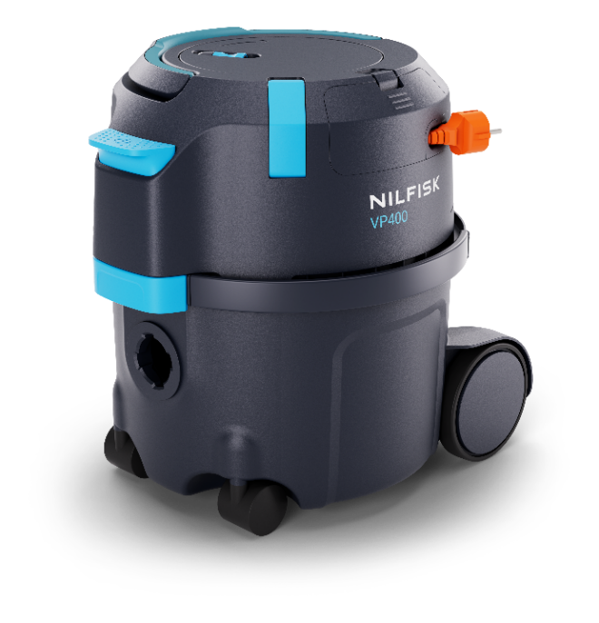
VP400 Summary
Old vs New (upgrade colored area)
Feature | VP600 | VP400 (New)
Machine bumper | • | •
Foot operated power switch | • | •
Tube parking position | • | •
HEPA filter | • | •
Accessories storage | • | •
Highlighted touchpoints |  | •
No-tool HEPA Filter access |  | •
Protected lock mechanism |  | •
Detachable cord standard |  | •
Reliable and durable rewind system |  | •
Lightweight & Compact footprint |  | •
Ergonomic foldable handle |  | •
Improved accessory storage |  | •
Cord hook for quick park/shift of location |  | •
VP600
VP400 (New)

Slide 17
VP300 Technical spec
 | Country variant |  |  | UK
 | Item number |  |  | 107421146 | 107421147 | 107421159
 | Description | Note |  | VP300 HEPA C UK | VP300 HEPA ECP S2 UK | VP300 R HEPA EC UK
Technical data
Voltage/Frequency | V/Hz |  |  | 220-240/ 50-60 | 220-240/ 50-60 | 220-240/ 50-60
Protection class / IP protection |  |  |  | II / IP20 | II / IP20 | II / IP20
Rated Power | W |  |  | 700 | 700 | 700
Suction Power (end of tube) | W |  |  | 225 | 225 | 225
Airflow (end of tube) | l/s |  |  | 32 | 32 | 32
Vacuum at nozzle | kPa |  |  | 22 | 22 | 22
Working sound level @2m (IEC 60335-2-69) | dB(A) | Sound pressure level at working position; 2m distance |  | 51 | 51 | 51
Sound pressure level @1m (IEC 60335-2-69) | dB(A) |  |  | 56 | 56 | 56
Dust bag capacity | L |  |  | 10 | 10 | 10
Main filter type |  |  |  | HEPA 13 | HEPA 13 | HEPA 13
Main filter area | cm² |  |  | 2400 | 2400 | 2400
Cord length | m |  |  | 10 | 10 | 10
Working radius | m |  |  | 12,5 | 12,5 | 12,5
Weight (machine) | Kg | machine only |  | 4,5 | 4,5 | 4,5
Dimensions (LxWxH) | mm |  |  | 398x340x395 | 398x340x395 | 398x340x395
Features
Detachable cord |  |  |  | • | • | •
HEPA Filtration |  |  |  | • | • | •
Recycled material |  |  |  |  |  | •
Durable rewind system
Silent mode |  | (Dual speed) |  |  | •
Dual cord storage
Triple cord storage |  |  |  | • | • | •
Tube parking |  |  |  | • | • | •
Tool storage |  |  |  | • | • | •
Ergonomic handle |  |  |  | • | • | •
Ergo bent-end |  |  |  | • | • | •
Ergo+ bent-end |  | 2k/soft overmold |  |  | •
Dust bags |  |  |  | 1-P | 1-P | 1-P
Technical specification of range
*Co-branded/private label models not included in sales presentation

Slide 18
VP300 Configuration
 | Country variant |  |  | UK
 | Item number |  |  | 107421146 | 107421147 | 107421159
 | Description | Note |  | VP300 HEPA C UK | VP300 HEPA ECP S2 UK | VP300 R HEPA EC UK
Accessories
Tubes
Extension tube steel D32 – Black | 140 8246 040 |  |  | •
Extension tube aluminium – Black | 107421471 | new PN |  |  | • | •
Telescopic tube aluminium – Black/Blue | 107421463 | new PN
Extension tube steel 450 mm | 140 8246 050
Hose & Bent-end
Hose CPL W Bent-end D32 | 107421450 |  |  | • |  | •
Hose CPL W Bent-end PREM D32 | 107421451 |  |  |  | •
Bent-end | 107421446
Bent-end PREM | 107421445
Hose W Connectors | 107421449
Floor Nozzles
Multi surface nozzle | 140 6700 540
Combi nozzle RD295P W.Clip | 107417790 |  |  |  | •
Combi nozzle RD295 | 140 8492 520
Combi nozzle RD277 | 107411677 |  |  | • |  | •
Combi nozzle JP | 107405141
Filters & Bags
HEPA 13 filter | 147 1250 600 |  |  | • | • | •
HEPA 14 filter | 107421443
Standard filter | 107421444
Sack prefilter | 147 1432 500 |  |  | • | • | •
Motor filter | 140 1535 510 |  |  | • | • | •
Fleece dust bag 10-P | 82367820
Paper dust bag 5-P | 82367810
Paper dust bag 10-P | 140 8618 000
Reusable dust bag 1-P (cloth) | 22251800
Maintenance Kit VP300 – LIGHT | 107421454 | fits also VP400
Maintenance Kit VP300 – PLUS | 107421455 | fits also VP400
Other accessories
Round brush | 140 8244 500 |  |  | • | •
Crevice nozzle | 147 0146 500 |  |  | • | •
Premium HF nozzle 350mm | 107413080 | grey currently
Premium HF nozzle 495mm | 107413081 | grey currently
Radiator crevice | 81530400 | grey currently
How are the machines equipped?
*Co-branded/private label models not included in sales presentation

Slide 19
VP400 Technical Spec
 | Country variant |  |  | UK
 | Item number |  |  | 107421170
 | Description |  |  | VP400 HEPA XECP UK
Technical data
Voltage/Frequency | V/Hz |  |  | 220-240/50-60
Protection class / IP protection |  |  |  | II / IP20
Rated Power | W |  |  | 700
Suction Power (end of tube) | W |  |  | 225
Airflow (end of tube) | l/s |  |  | 32
Vacuum at nozzle | kPa |  |  | 22
Working sound level @2m (IEC 60335-2-69) | dB(A) |  |  | 51
Sound pressure level @1m (IEC 60335-2-69) | dB(A) |  |  | 56
Dust bag capacity | L |  |  | 10
Main filter type |  |  |  | HEPA 13
Main filter area | cm² |  |  | 2400
Cord length | m |  |  | 15
Working radius | m |  |  | 17,5
Weight (machine) | Kg |  |  | 5,5
Dimensions (LxWxH) | mm |  |  | 398x340x395
Features
Detachable cord |  |  |  | •
HEPA Filtration |  |  |  | •
Recycled material
Durable rewind system |  |  |  | •
Silent mode
Dual cord storage |  |  |  | •
Triple cord storage
Tube parking |  |  |  | •
Tool storage |  |  |  | •
Ergonomic handle |  |  |  | •
Ergo bent-end
Ergo+ bent-end |  |  |  | •
Dust bags |  |  |  | 1-P
Technical specification of range
*Co-branded/private label models not included in sales presentation

Slide 20
VP400 Configuration
 | Country variant |  |  | UK
 | Item number |  |  | 107421170
 | Description | Note |  | VP400 HEPA XECP UK
Accessories
Tubes
Extension Tube Steel D32 – Black | 140 8246 040
Extension Tube Aluminium – Black | 107421471 | new PN |  | •
Telescopic Tube Aluminium – Black/Blue | 107421463 | new PN
Extension Tube Steel 450mm (short) | 140 8246 050
Hose & Bent-end
Hose CPL W Bent-end D32 | 107421450
Hose CPL W Bent-end PREM D32 | 107421451 |  |  | •
Bent-end | 107421446
Bent-end PREM | 107421445
Hose W Connectors | 107421449
Floor Nozzles
MULTI SURFACE NOZZLE | 140 6700 540
COMBI NOZZLE RD295P W.CLIP | 107417790 |  |  | •
COMBI NOZZLE RD295 | 140 8492 520
COMBI NOZZLE RD277 | 107411677
COMBI NOZZLE JP | 107405141
Filters & Bags
HEPA 13 filter | 147 1250 600 |  |  | •
HEPA 14 filter | 107421443
Standard filter | 107421444
Sack Prefilter | 147 1432 500 |  |  | •
Motor Filter | 140 1535 510 |  |  | •
Fleece Dust Bag 10-P | 82367820
Paper Dust Bag 5-P | 82367810
Paper Dust Bag 10-P | 140 8618 000
Reusable dust bag 1-P (cloth) | 22251800
Maintenance Kit VP300 – LIGHT | 107421454 | fits also VP400
Maintenance Kit VP300 – PLUS | 107421455 | fits also VP400
Other accessories
Round brush | 140 8244 500 |  |  | •
Crevice Nozzle | 147 0146 500 |  |  | •
Premium HF nozzle 350mm | 107413080 | grey currently
Premium HF nozzle 495mm | 107413081 | grey currently
Radiator crevice | 81530400 | grey currently
How are the machines equipped?
*Co-branded/private label models not included in sales presentation

Slide 21
VP300 Hierarchy
New Global PNs*
Platform – L4 | Variant – L5 | PN | Machine Level – L6
97452 – VP300 ll | VP300 | 107421148 | VP300 HEPA C US
 | VP300 | 107421155 | VP300 ZA
 | VP300 | 107421152 | VP300 C AU/NZ
 | VP300 Basic | 107421150 | VP300 R BASIC XC JP
 | VP300 Basic | 107421154 | VP300 BASIC C CN
 | VP300 | 107421153 | VP300 HEPA TC AU/NZ
 | VP300 Basic | 107421151 | VP300 R HEPA BASIC XC JP
 | VP300 | 107421158 | VP300 HEPA XT CN
 | VP300 | 107421160 | VP300 HEPA PINK EC AU/NZ
 | VP300 S2 | 107421142 | VP300 HEPA EP S2 EU
 | VP300 | 107421143 | VP300 HEPA EC EU
 | VP300 | 107421145 | VP300 HEPA XT EU
 | VP300 | 107421156 | VP300 HEPA PINK T EU
 | VP300 | 107421149 | VP300 HEPA TC CH
 | VP300 Basic | 107421144 | VP300 HEPA BASIC EU
 | VP300 | 107421146 | VP300 HEPA C UK
 | VP300 S2 | 107421147 | VP300 HEPA ECP S2 UK
 | VP300 | 107421157 | VP300 R HEPA T EU
 | VP300 | 107421159 | VP300 R HEPA EC UK
*Co-branded/private label models not included in sales presentation

Slide 22
VP400 Hierarchy
New Global PNs*
Platform – L4 | Variant – L5 | PN | Machine Level – L6
97454 – VP400 | VP400 | 107421169 | VP400 HEPA XEC EU
 |  | 107421171 | VP400 HEPA XT EU
 |  | 107421172 | VP400 HEPA EC EU
 |  | 107421177 | VP400 R HEPA XT EU
 |  | 107421173 | VP400 HEPA XTCP CH
 |  | 107421170 | VP400 HEPA XECP UK
 |  | 107421174 | VP400 HEPA CP US
 |  | 107421175 | VP400 HEPA XTCP AU/NZ
 |  | 107421176 | VP400 HEPA X CN
 |  | 107421169 | VP400 HEPA XEC EU
 |  | 107421171 | VP400 HEPA XT EU
 |  | 107421172 | VP400 HEPA EC EU
*Co-branded/private label models not included in sales presentation

