Slide 1
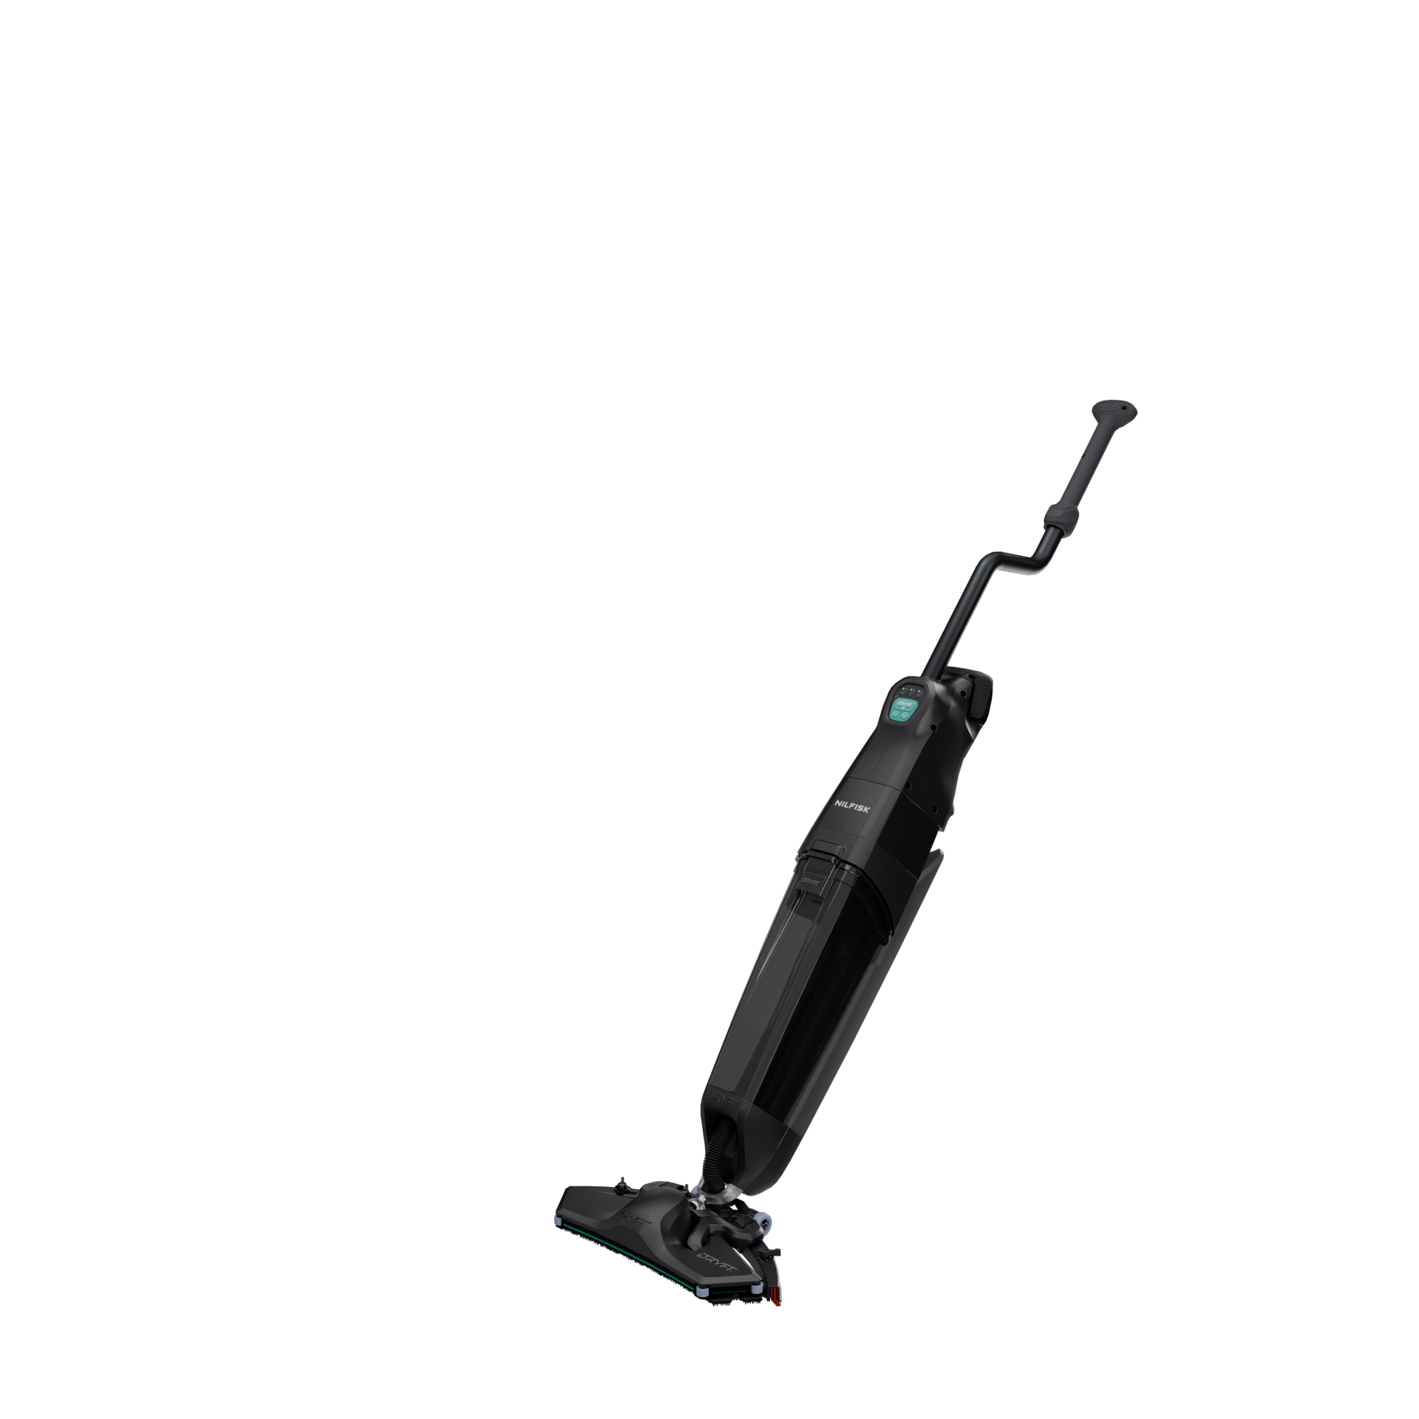
Nilfisk Dryft
Preliminary sales presentation

Slide 2
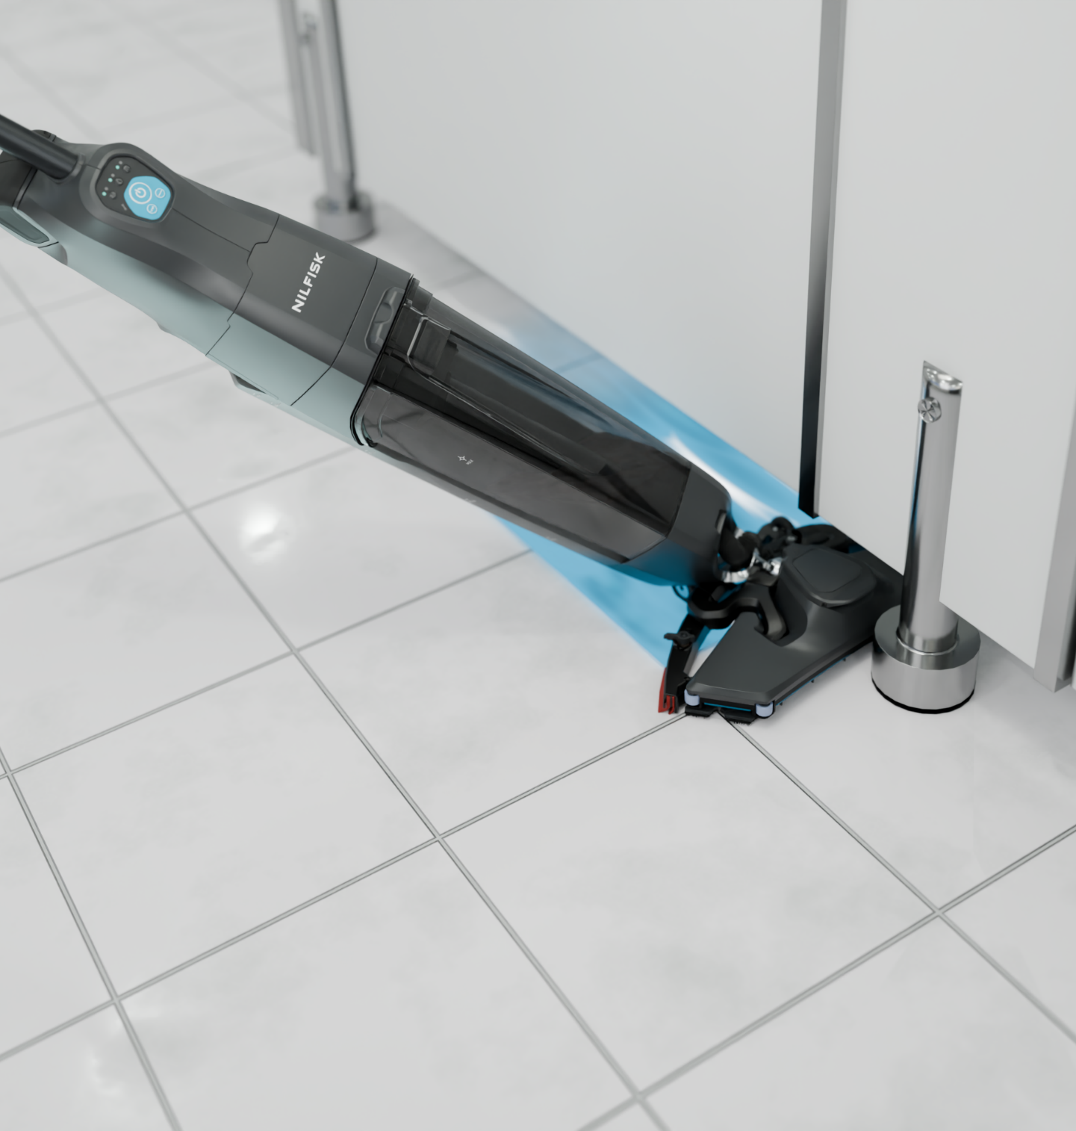
Nilfisk Dryft
A superior, more hygienic way to clean small spaces.
Nilfisk Dryft is a revolutionary breakthrough in floor cleaning technology.
With its patented ultra low-profile head shape and groundbreaking 4.200rpm scrubbing technology, it cleans tricky areas faster, with little physical effort.
Nilfisk Dryft is a new solution to expand your portfolio and create new revenues streams for your business.

Slide 3
Value proposition
The Nilfisk Dryft revolutionises the way the world cleans small spaces. It is a micro scrubber dryer that cleans the hardest to reach areas, providing both larger companies and small businesses with a more hygienic and more effective alternative to a mop and bucket.
Innovation
Clean small spaces
Focus on key application
Micro scrubber-dryer
Definition of what the machine is: a new category in Nilfisk portfolio
Hard-to-reach areas
Focus on differentiator against I-Mop
Both large and small business
For large companies we can provide Dryft as a complement to their fleet together with other machines. We enter a new segment when mentioning small businesses
Hygiene
Primary value: Dryft is more hygienic and more effective than mop
Differentiation against mop&bucket

Slide 4





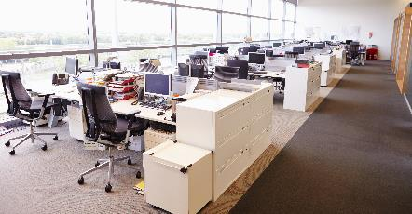

Target segments
Contract cleaners
Retail
Institutions
Healthcare
Education
Public administration
and offices
Hospitality

Slide 5
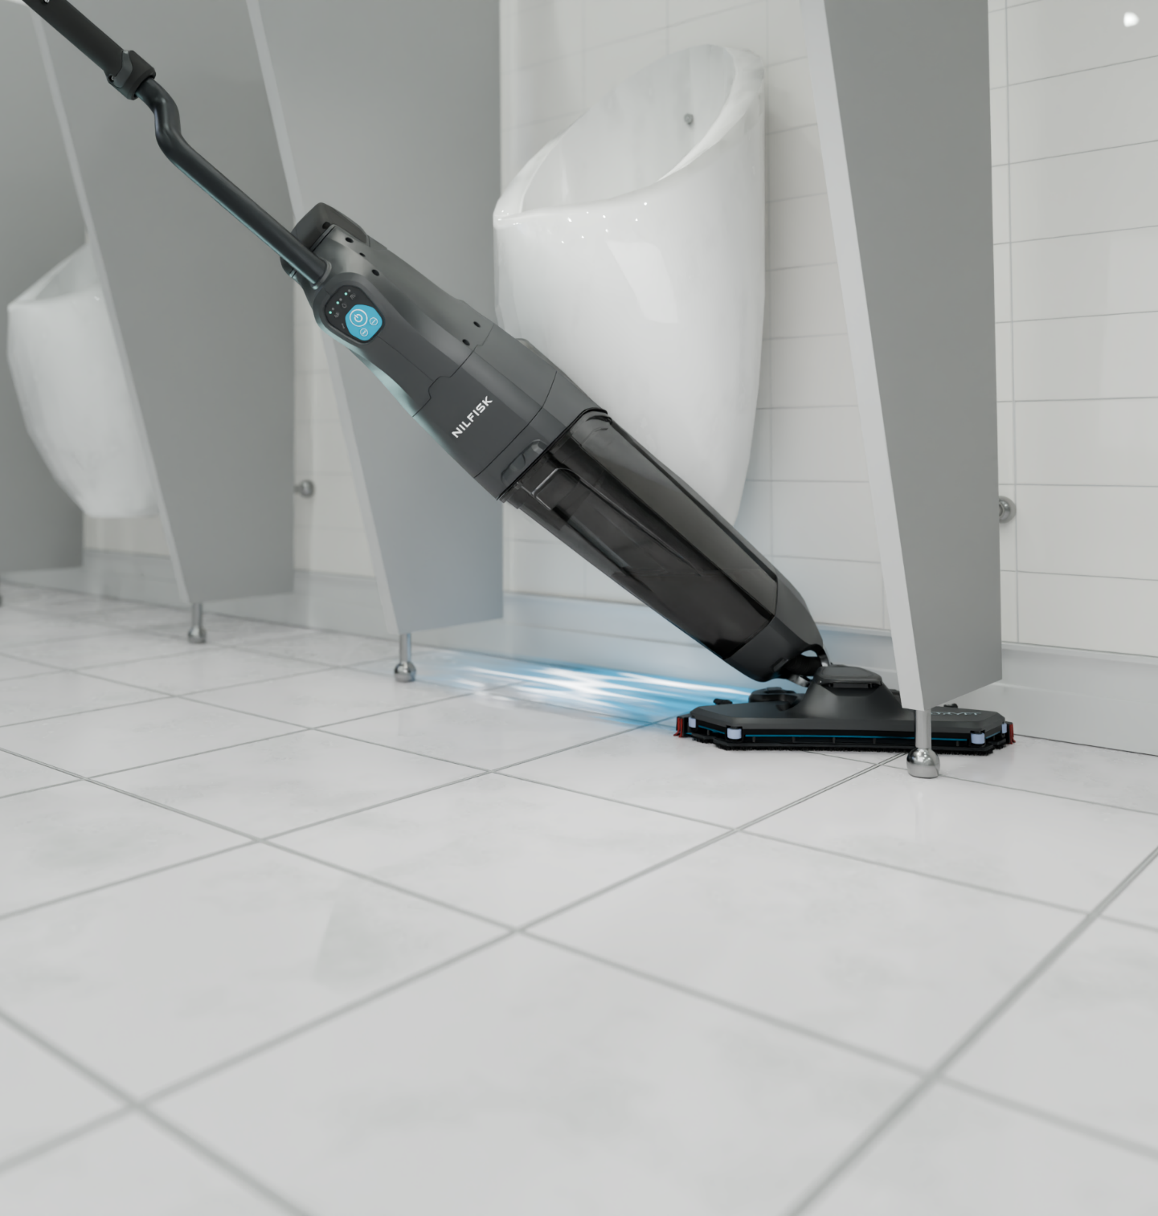
Key applications and jobs to be done
Cleaning of facilities in sizes ranging from 1 to 50 m²
Daily cleaning of toilets, restrooms, cloakrooms, small offices, restaurant dining areas, etc.
Edge/precision cleaning
Cleaning of hard-to-reach spots (corners, below shelves and furniture)
Spot cleaning in high traffic areas (entrance, lobbies etc.)

Slide 6
Key values, benefits and proof-points
Hygiene
Remove harmful bacteria and protect your team and staff with vastly improved hygienic cleaning equipment
Unlike traditional mops which move bacteria and filth around with them, the Nilfisk Dryft doesn’t need to be dunked back into a dirty bucket to do its job, making for a vastly improved, more hygienic clean.
Proven to clean more effectively than traditional manual methods.
Removes harmful bacteria more thoroughly and efficiently.
Cleaning performance
Ensure a high standard of clean and optimal coverage without interruptions.
The Nilfisk Dryft’s vibrating orbital scrub head delivers 4,200 vibrations a minute, resulting in a more thorough clean in smaller spaces and wide-reaching coverage with less elbow grease required.
Vibrating orbital scrub head delivers high cleaning performance (4,200 vibrations per min.)
Uses 1/3 less water compared to similar products, so you get more cleaning done between refills.
Quick battery charge and swap. Li-ion battery with 1 hour runtime/charge time
Ease of use/Convenience
Get staff up and running quickly with minimal training.
There’s no heaving mops and buckets about with the Nilfisk Dryft. It is light enough to carry around and easy for all staff to handle, plus its ergonomic design makes it easy on the arms, as well as on the eye.
Easy access and magnetic click-on/off system for quick replacement of brush
Modular motor - easy to access and replace
High serviceability based on easy exchangeable service kits.
Anti-slip handle for control and safety
Light weight and easy to handle and transport
Designed for ensuring good and healthy working positions
Low noise operation
3 button operation UI with easily adjustable settings. Can be operated with minimal training
Agility
Clean in hard-to-reach areas using familiar motion and technique.
The Nilfisk Dryft is flexible. It can clean in a forwards and backwards motion, below furniture and shelves and has a unique scrubbing deck shape: perfect for corner and edge cleaning.
Design provides unprecedented mobility, flexibility and agility for movement and cleaning for the operator
Can clean in a forward motion like a scrubber and in a backwards motion like a mop depending on the need in the area.
Low profile scrubbing deck to clean below furniture and shelves​
Unique scrubbing deck shape for corner and hedge cleaning

Slide 7
Key features and design
Ergonomic S-handle
enables the user to effortlessly guide the machine in the fast S-motion
Spin handle
Keeps your upper hand stationary allowing the machine to rotate effortlessly
Simple controls
Switch between smooth or rough floor mode at the press of a button
Service Kits
All serviceable parts are quick and easy to change (suction motor, solenoid valve, squeegees…)
Li-Ion battery
Quick change battery technology,
60 mins runtime
Magnetic recovery tank
Easy to clean and empty
Quick fill magnetic tank
2.5-liter clean water capacity
Smart head stand
Simply press the pedal to stand Nilfisk Dryft upright
Transportation wheels
Flip the head onto the transport wheels for easy transportation
Quick release squeegee
Tool-less design for easy maintenance
Efficient water release
High performance cleaning with just water, thanks to 4,200 rpm scrubbing action
Patented ultra low-profile head shape
Precision cleaning, also under low furniture
Magnetic cleaning pad
Featuring color coding
Wall protection guide wheels
Non-marking soft rubber

Slide 8

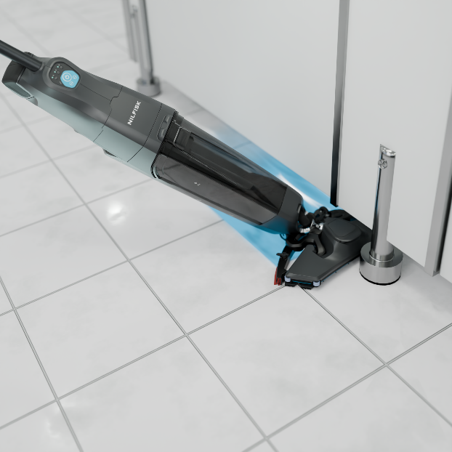
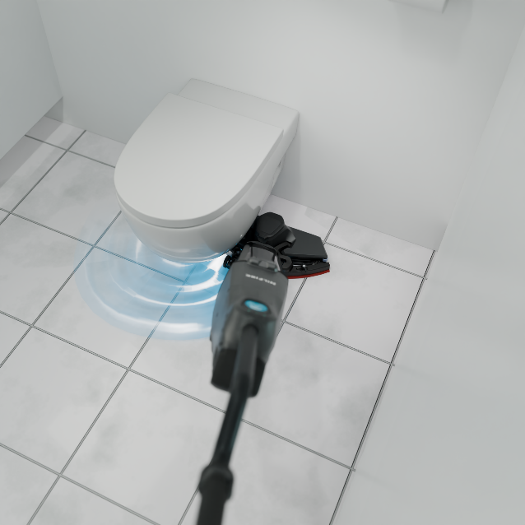
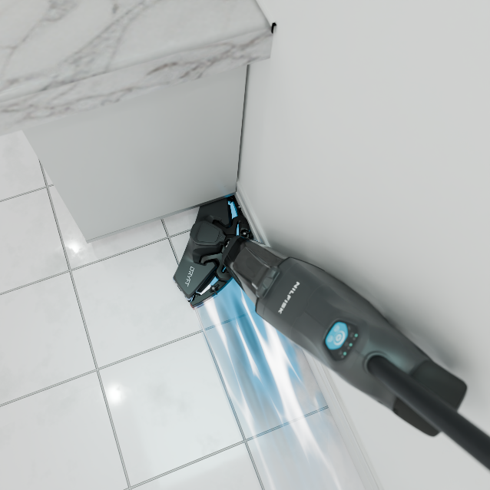
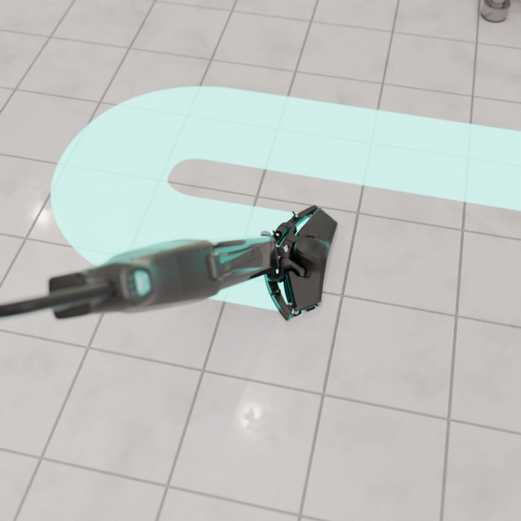
Key applications
Low profile
Hard-to-reach areas
Corner cleaning
S- motion
Patented ultra-low profile head shape for cleaning underneath partitions and furniture as low as 5 cm.
Its patented head shape and the agility of the S-motion are the key to the cleaning ability, so you can efficiently clean around toilets in seconds.
Nilfisk Dryft scrubs and dries deep into corners, thanks to the chamfered edges on the cleaning head.
The S-motion effortlessly guides the machine, requiring the user to walk less and allowing to increase the floor cleaning productivity.

Slide 9
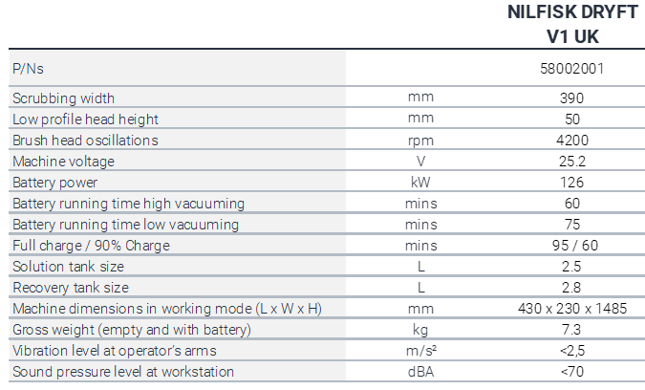
Technical data
Please note: information based on pre-production machines tests. Official specs will be released upon launch.

Slide 10
Nilfisk Dryft P/Ns
P/Ns | Master Description | Models | L4 | L5
58002001 | NILFISK DRYFT V1 UK | UKI | 94720 | 8206
Nilfisk Dryft Accessories
P/Ns | Description | Accessory Group | Qty | Nilfisk Dryft V1 UK 58002001
58002028 | HOLDER PAD SIP | Pad holder | 1 | ✔
58002029 | PAD CLEANING SINGLE SIP | Special pad | 1 | ✔
58002060 | BLADE SQUEEGEE (LINATEX) KIT | Squeegee blade | 1 | ✔
58002020 | BATTERY LI-ION DRYFT 25.2V 5AH SIP | Battery | 1 | ✔
58002022 | BATTERY LI-ION DRYFT 25.2V 5AH US SIP | Battery | 1 | -
58002030 | CHARGER LI-ION DRYFT 24V 5A UK KIT | Charger | 1 | ✔
58002031 | CHARGER LI-ION DRYFT 24V 5A EU KIT | Charger | 1 | -
58002033 | CHARGER LI-ION DRYFT 24V 5A US KIT | Charger | 1 | -

