Slide 1
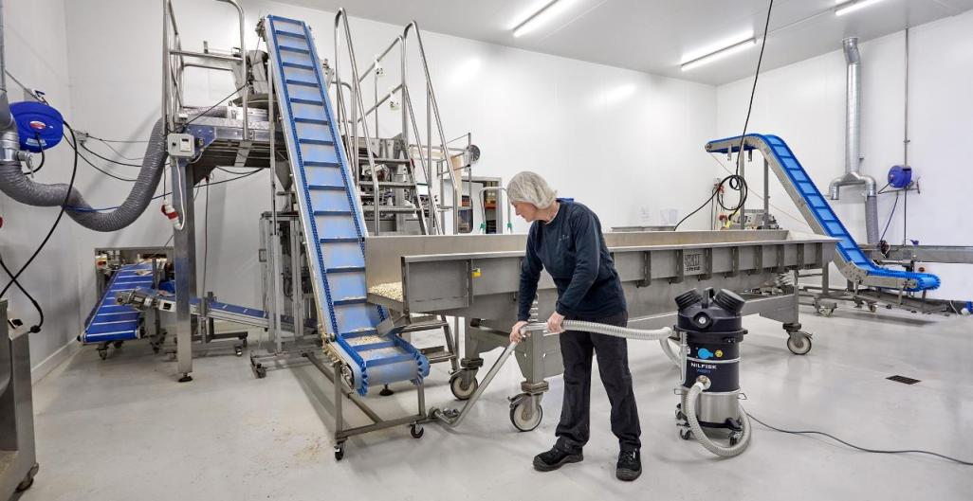
VHS010-VHS011
The mini industrial vacuums range

Slide 2
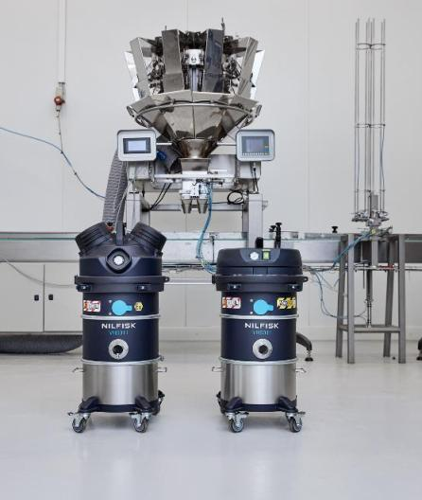
Agenda
1
Mini IVS range
and layouts
4
Accessories
2
Jobs to be done
5
Technical specification
3
Key features
and benefits
6
Naming and hierarchy

Slide 3
1
Mini IVS range and layouts

Slide 4
Introducing the mini industrial vacuums
Say hello to Nilfisk’s new range of mini industrial vacuums. Don’t let their size fool you – you still get all the power, safety, and durability you find in our larger vacs, just with a smaller, more flexible footprint. In a nutshell, your needs have been built into every aspect of our Mini Industrial Vacuums.
The range consists of four distinct models, each built to address specific levels of safety needs for hazardous, combustible, and conductive dust. With filters that meet the highest levels of safety requirements, the range ensures a secure, dust-free environment. Don’t take our word for it – all our vacs are 3rd party certified to comply with global safety regulations.
Small but mighty, Nilfisk Mini Industrial Vacuums provide uncompromised power, featuring the most efficient motor in their class. You will experience a perfect blend of safety, affordability, and unparalleled suction capability, ensuring optimal cleaning performance without sacrificing power.
Whether complementing your larger vacuums or as a standalone vac in smaller production settings with low to medium quantities of dust, our range seamlessly adapts to your unique cleaning needs. It’s a versatile powerhouse that will quickly become your go-to solution for ensuring workplace safety and high-performance cleaning in even the tightest spaces.
Nilfisk Industrial Vacuum Solutions. Your Needs Built In.
Meet Nilfisk’s Mini Industrial Vacuums
Small but mighty.
Maximum performance, safety, and flexibility. Minimum footprint.

Slide 5
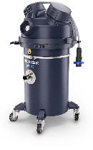
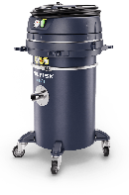
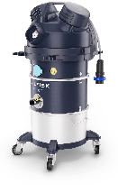
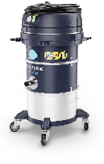
Mini IVS
Range introduction
Introduction
Mini-IVS is a platform of industrial vacuum cleaners designed to meet the customer demand for a small and light solution for the safe recovery of low to medium quantities of combustible dust and hazardous dust in classified and not classified zones.
The range includes basic and premium models to meet different needs in terms of cost/features. All the models are third party certified (ATEX, CIID2, ACD, M and H).
Range key features:
One layout with safe disposal – body 010;
One layout with pull clean filter cleaning system without needs of consumable – body 011
Lightweight and robust, perfect solution for fast and frequent cleaning job also in narrow spaces or when the are obstacles on the floors or difficult places to reach
New dedicated range of industrial reduced footprint accessories, EXA and ACD
MEET NILFISK’S MINI INDUSTRIAL VACUUMS
Small but mighty.
Maximum performance, safety, and flexibility. Minimum footprint.

Slide 6
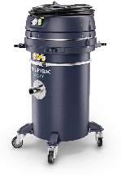


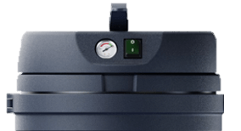
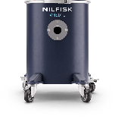
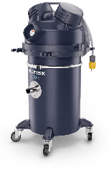


Mini IVS
Layout
IP44
Safe disposal
4 models available
Container, 30L
Configuration: bag filter + safety filter H14
Suitable for combustible dust and ATEX
Suitable for hazardous dusts L or H
VHS010 HC ACD
VHS010 LC ACD
Body VHS010
IP65
VHS010 HC Z22 EXA
VHS010 LC Z22 EXA

Slide 7

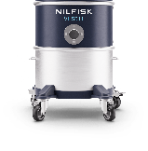
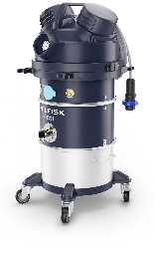

Mini IVS
Layout
Pull&Clean
2 models available
Container 15 L with removable whee-lbase
Optional Upstream HEPA14 filter (US included)
Suitable for combustible dust and ATEX
Suitable for hazardous dust L
IP44
VHS011 LC ACD
Body VHS011
IP65
VHS011 LC Z22 EXA

Slide 8
2
Primary application and use

Slide 9
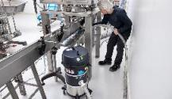
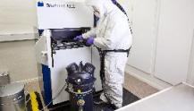
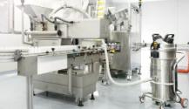
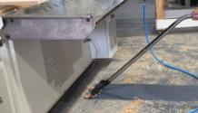
Key features and benefits
Typical cleaning job:
  Cleaning packaging machine or process equipment as conveyor belts, mixer, mill etc.
  Cleaning of floors, desks, surfaces
Key features:
  For Z22 Atex zones and for combustible dusts
  Long life filter and no consumables
  Washable container
  Food colored accessories
Typical cleaning job:
  Collection and cleaning metal 3D printers, glove box, finished parts, emptying bins…
Key features:
  Certified for conductive combustible dust, safe with IP65 enclosure
  Safe bag system disposal and H CLASS certified
Typical cleaning job:
  Cleaning pharmaceutical process machines or process equipment
  Cleaning of floors, desks, surfaces in production area
Key features:
  Fully Stainless-steel body
  HEPA14 filtration
  Not contaminating working environment
Typical cleaning job:
  Collection of dust and wood chips from automatic machines and equipment
  Cleaning of floors, desks, surfaces
Key features:
  Suitable for hazardous and combustible dusts, as ex painted wood dust or very fine dusts
Food Industry
Primary and secondary packaging
AM industry*
Production line, part of the process
Pharma industry
Primary and secondary packaging
Generic manufacturing
Textile, Wood, Painting, furniture
* Not for north America

Slide 10

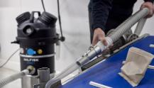
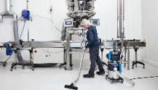
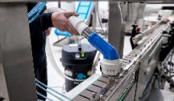
Food industry application focus
Jobs to be done / relevant areas
Final product packed in direct contact with its packaging
Job-To-Be-Done for VHS011 LC Z22: floor cleaning
Final product packed in direct contact with its packaging
Job-To-Be-Done for VHS011 LC Z22: cleaning packaging lines in narrow spaces
cleaning of conveyor belts and packaging machine
Final product packed in direct contact with its packaging
Job-To-Be-Done for VHS011 LC ACD: floor cleaning
Final product packed in direct contact with its packaging
Job-To-Be-Done for VHS011 LC ACD: cleaning packaging lines in narrow spaces
cleaning of conveyor belts and packaging machine
 Primary packaging
classified zone
 Primary packaging
 Primary packaging
 Primary packaging
not classified zone
Classified zone
Classified zone
Combustible dust
Combustible dust

Slide 11
3
Key features and benefits

Slide 12
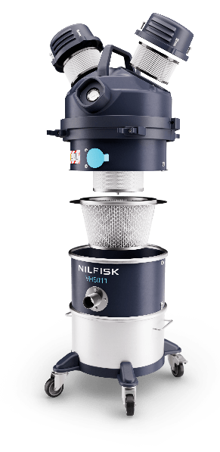
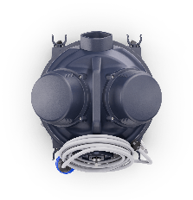
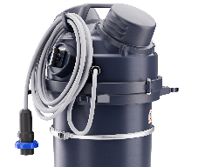

Key features and design
Handle and power cord holder
VHS011 Z22 EXA / C2D2
Power cord
9 meters
Plug
2P+T
Vacuum gauge for a constant monitoring of the performance and filtration efficiency
Free dust motor enclosure with a protection rate IP65
Rounded shape for an easy cleaning of the overall surface
PullClean cleaning filter system, easy and efficient operation
Quiet – only 72 dB(A) level noise
High efficiency filters: M-Class (as standard);
PTFE or HEPA 14 upstream filter 99,995% 0.1 - 0.2 microns (as option) all filters are antistatic
Easy and fast service: everything quickly accessible
Accessories holder
Fully grounded and bonded, avoids electrostatic sparks, electrical hazard
Safe and mistake proof connection for certified ATEX accessories Ø40 EXA
Main switch ATEX
15 L removable container AISI304, easily washable thanks to removable wheel-base
Parking brake, stable also on slightly sloped
Cable gland ATEX
High maneuverability thanks to
the 4 ball bearing pivoting wheels
Brushless motor
up to 10.000 hours
Antistatic wheels

Slide 13
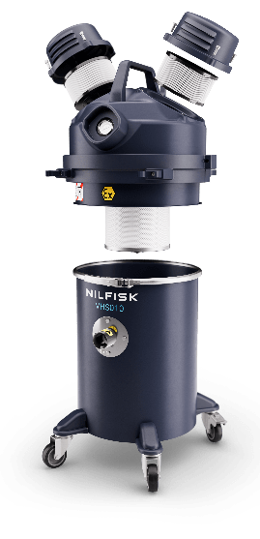

Key features and design
Handle and power cord holder
VHS010 Z22 EXA / C2D2
Power cord
9 meters
Plug
2P+T
Vacuum gauge for a constant monitoring of the performance and filtration efficiency
Free dust motor enclosure with a protection rate IP65
HEPA 14 safety filter efficiency 99,995% 0.1 - 0.2 microns
Rounded shape for an easy cleaning of the overall surface
30 L externally painted AISI 304 container
Quiet – only 72 dB(A) level noise
Safe and mistake proof connection for certified ATEX accessories Ø40
Accessories holder
Fully grounded and bonded, avoids electrostatic sparks, electrical hazard
Convenient and safe disposal system
Main switch ATEX
Parking brake , stable also on slightly sloped
Cable gland ATEX
Antistatic wheels
High maneuverability, container
with 4 ball bearing pivoting wheels
Brushless motor
up to 10.000 hours

Slide 14
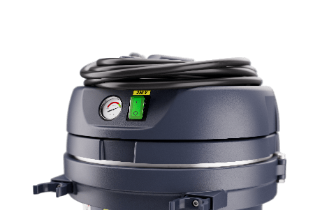


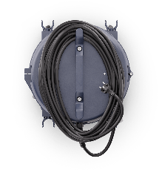
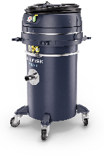
Key features and design ACD models
VHS011 LC ACD VHS010 LC/HC ACD
3
4
1
2
Handle and power cord holder
Power cord
9 meters
ACD motor head has some difference from the Z22 / C2D2 versions.
All other parts not described in this ACD deep dive are the same
of Z22 / C2D2 variants
Schuko plug (EU)
1 | Vacuum gauge for a constant monitoring of the performance and filtration efficiency
2 | Standard main switch with green light
3 | Quiet – only 70 dB(A) level noise
4 | Light weight conductive plastic motor-head enclosure with a protection rate IP44
Accessories holder
Standard inlet

Slide 15
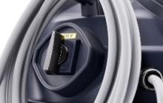
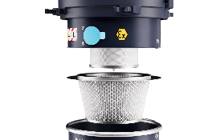
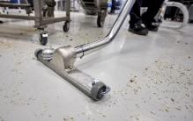
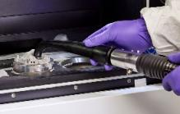
Key features and benefits
Electrical component externally installed, third party certified – means highest level of safety for operators and business ‘s protection against useless risks.
Primary filter M Class – optimal filtration of fine dusts; safe bag system protects operators' exposure.
HEPA14 Filtration – arrests 99,995% of particles, size range 0.1 - 0.2 µ m.
Accessories storage solution on machine – space to store essential accessories required for the task.
Long life components – cartridge filters build with metal housing, use best materials.
Low TCO – PullClean filter cleaning system perfectly keep efficient the filtration, less downtime and less maintenance.
Reduced dimension and weight accessories where possible – e.g. floor nozzle reduced to 300 mm as the handgrip ,now also in two pieces.
Incredibly maneuverable – wheel-base and low weight makes the IVAC easy to move and control also in tight spaces.
Fit for purpose long life components – brushless motor ensure incredible long-life, up to 10.000 hours;
1 motors 950W achieve required suction power – even with heaviest dust s like metal dusts, the collection is efficient and fast.
Safety
Electrical components – Filtration – Operator protection
Productivity
Everything designed for longer lifetime
Comfort
Increasing comfort to improve productivity
Performance
Having the power to achieve
specific tasks

Slide 16
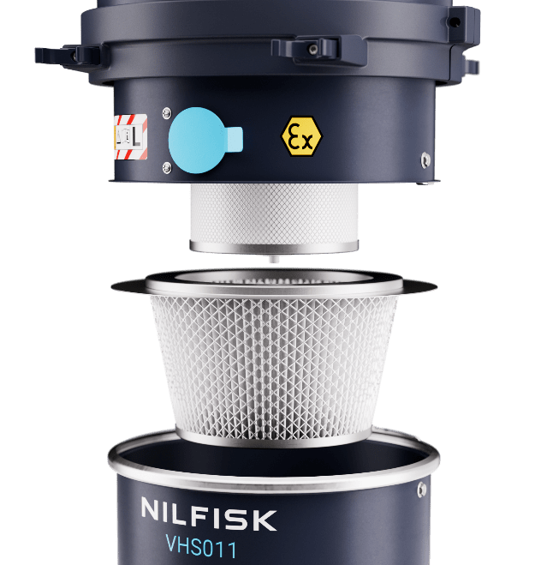

PullClean
L Class VHS011…
Efficient filter cleaning
Description
Pull clean filter cleaning system is a manual system with which operator can easily clean the filter and keep high the efficiency of the vacuum cleaner.
How it works
The cleaning of the filter is done with the inlet of the machine closed.
Three rapid opening and closing of the blue flap create a counter impulsive flow into the filter that is in this way cleaned.
Rapidly repeat the cleaning process for three times for the perfect cleaning of the filter
Value and benefit
Reduced maintenance
Stable performance make faster the cleaning job
Safe method of clean the filter without stop the suction

Slide 17
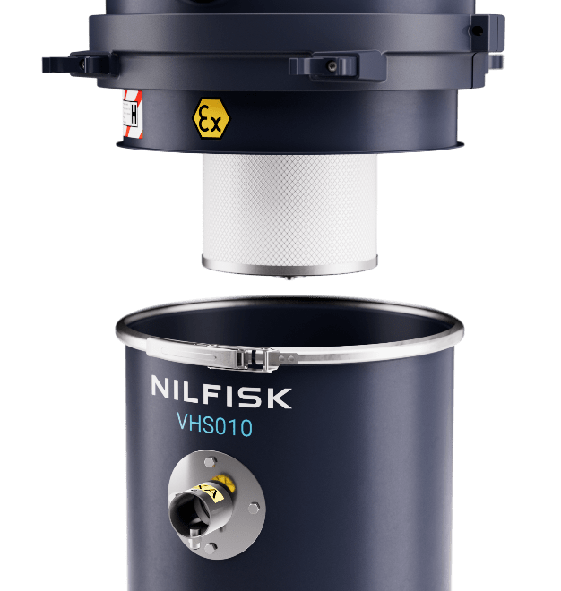

Safe bag system
No dust exposure
H Class VHS010….
Description
HCLASS certified models are quipped with the safe bag system; this disposal system allow to dispose the collected material without being in contact with the material itself.
How it works
It is built with a CLASS M fleece filter and a special bag inlet with safety guillotine valve, externally protected by a conductive and resistant plastic bag.
The bag filter safely collect the material, external plastic bag protects operator from the contact with the filtering bag during the disposal procedure.
The guillotine valve, when manually closed, avoid any leakage of dust from the inlet of the safe bag system
Value and benefit
Perfect protection accordingly different types of hazardous dusts
Secondary protection with HEPA14 certified filter
Safe, easy and quick disposal system

Slide 18
4
Accessories

Slide 19
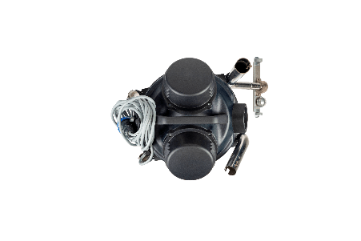
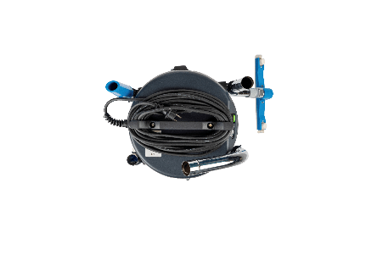
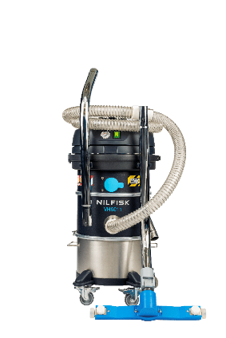
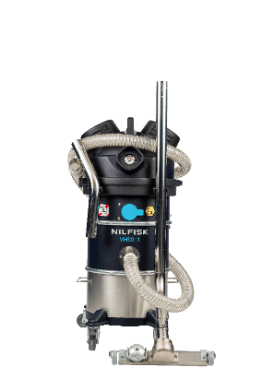
Accessory holder
Parking position
Description
Four convenient and robust clips, two each side, useful to easily transport up to 4 end tools
How it works
When IVAC is parked, the accessories holder can easily keep the new small handgrip and floor nozzle
Disconnect hose from IVAC’s inlet and handgrip for an easiest positioning
Disconnect bulky accessories, as handgrip and floor nozzle, before moving the machines
Value and benefit
Accessories always nearby
Parking with minimum space occupation

Slide 20













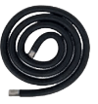
Mini IVS Z22
EXA connection with PIN
EXA Ø40 mm accessories
EXA antistatic hose 3 m
EXA bent connection
EXA conductive cone
EXA antistatic hose 3 m polyurethan FDA
EXA bent connection AISI 304
EXA antistatic cone silicon transparent
EXA flat lance AISI 304 300 mm NEW
EXA silicon nozzle with D40-32 reduction
EXA antistatic hose 3 m,
EXA bent connection AISI 304
EXA AISI 304 antistatic cone
EXA AISI 304 flat lance 300 mm NEW
EXA AISI 304 antistatic round brush
EXA small handgrip (for bent connection) NEW
EXA AISI 304 mobile floor nozzle
300 mm NEW
EXA antistatic hose 3 m FDA,
EXA bent connection AISI 304
EXA conductive cone black
EXA flat lance AISI 304 300 mm NEW
EXA conductive nozzle Ø 40-32
Basic Ø40 mm EXA (available also in combo version: CB)
4072400773
Machineries FDA Ø40 mm EXA
(complete) Ø40 mm
4072400822
General cleaning Ø40 mm
EXA
4072400824
Machineries conductive
Ø40 mm EXA (complete)
Ø40 mm
4072400823
2
2
2
4
7
5
5
2
4
4
5
6
3
1
3
1
1
3
1
3

Slide 21






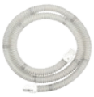


Mini IVS ACD and CIID2
ACD sleeve connection
ACD Ø40 mm accessories kits
Flex conductive hose 3 m + sleeves
AISI304 bent connection
Conductive cone
Basic ANTIST. Kit ACD Ø40
4072400825
Flex conductive hose 3 m + sleeves
AISI304 bent connection
Conductive cone
AISI 304 flat lance 300 mm NEW
Antistatic floor nozzle 300 mm NEW
AISI 304 small handgrip 2 parts NEW
Round antistatic brush
General kit ACD Ø40
4072400774
Antistatic FDA transparent hose 3 m + sleeves,
AISI 304 bent connection
Silicone Antistatic FDA Cone
Flat lance AISI 300 mm NEW
Reducer Ø40/Ø32 SS
Flexible nozzle autoclavable Ø32
AISI 304 flat lance (300 mm)
Machineries FDA ACD kit Ø40
4072400826
2
5
2
6
5
6
3
3
2
1
1
3
1
4
7
4

Slide 22
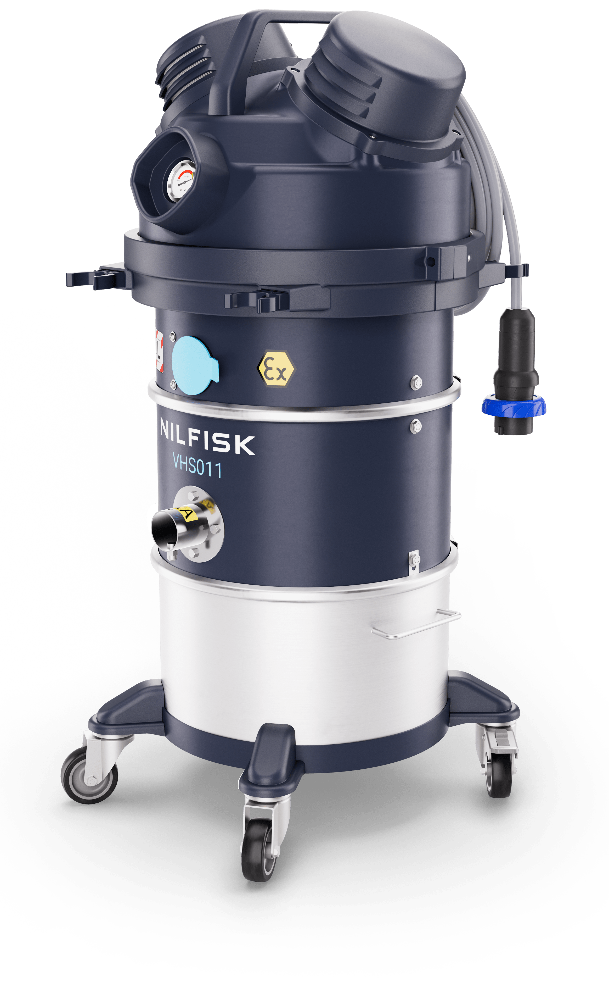
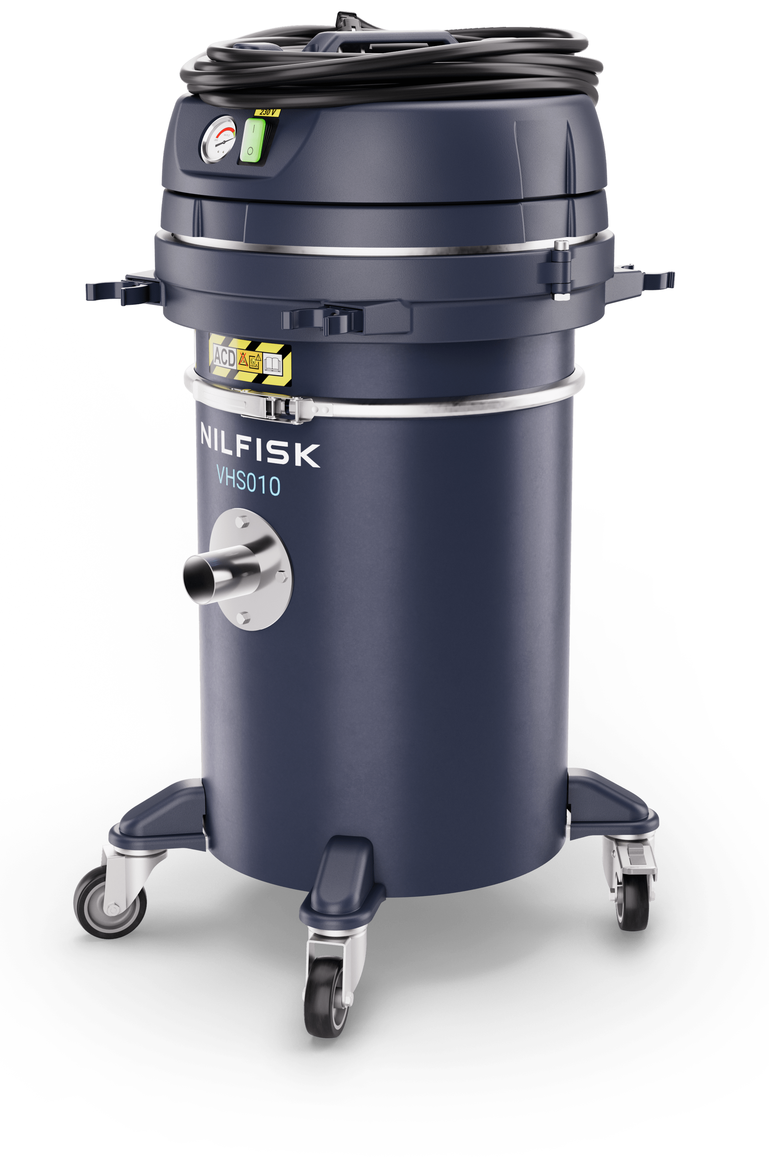

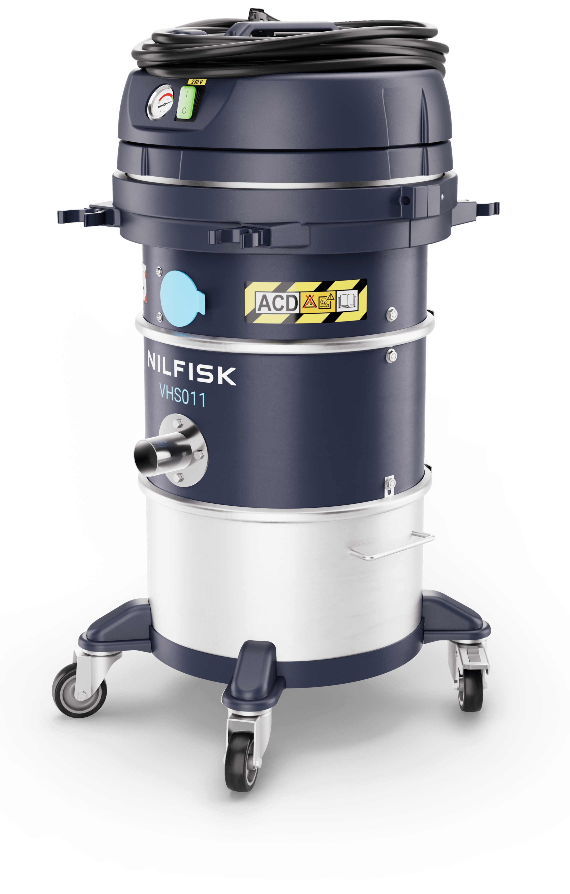
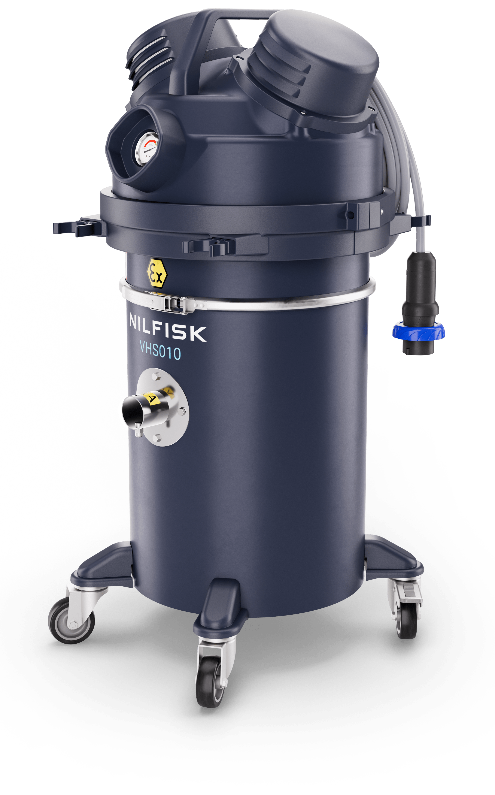
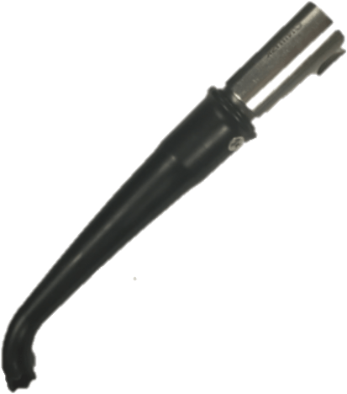
Mini IVS machine and accessories – suggested choice I
Food
Cleaning packaging machines
Metal & additive manufacturing
Cleaning 3D printers
General industry*
General cleaning solution
VHS011 LC Z22 EXA
4010100113
VHS011 LC Z22 EXA
4010100113
VHS010 MC ACD
TBD**
Hygienic container
Without consumable
FDA end tools and hoses
Hygienic container
Not contaminating env.
safe with conductive dusts
Affordable safe disposal
Light weight
Multipurpose premium IVAC
Accessories KIT FDA Machine EXA
4072400822
Accessories KIT Machine EXA
4072400823
Accessories KIT General ACD
4072400774
VHS011 LC ACD
4010100120
VHS010 MC Z22 EXA
TBD**
VHS010 MC Z22 EXA
TBD**
Hygienic container
Without consumable
FDA end tools and hoses
Safe dispose
Not contaminating env.
Safe with conductive materials
Affordable safe disposal
Light weight
Multipurpose premium Z22 IVAC
Accessories KIT FDA Machine ACD
4072400826
Accessories KIT Machine EXA
4072400823
Accessories KIT General EXA
4072400773
**From 09/2024
*wood, painting and many others

Slide 23







Mini IVS machine and accessories – suggested choice II
Electronics
Cleaning production machineries
Carpentry, mechanical workshop
Starter kit for general entry level application
Pharma and nutraceutical
Cleaning packaging machines
VHS011 LC Z22 EXA
4010100113
VHS010 LC ACD
4010100122
VHS011 LC Z22 EXA 3X AU
TBD**
High cleanability
Not contaminating env.
Safe with conductive materials
The most robust, compact and lightest industrial vac, with affordable, scalable, safe disposal options
High cleanability
Not contaminating env.
FDA end tools and hoses
Accessories KIT Machine EXA
4072400823
Accessories KIT Basic ACD
4072400825
Accessories KIT FDA Machine EXA
4072400822
VHS010 HC Z22 EXA
4010100116
VHS011 LC ACD
4010100120
VHS010 HC Z22 EXA 3X
TBD**
Safe dispose
Not contaminating env.
Safe with conductive materials
The most robust, compact and lightest industrial vac, with high performance filtration without consumable for high powder load
Safe disposal
Not contaminating env.
FDA end tools and hoses
Accessories KIT Machine EXA
4072400823
Accessories KIT Basic ACD
4072400825
Accessories KIT FDA Machie ACD
4072400822

Slide 24


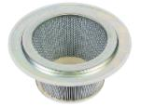

Spare filters for VH011...
VHS011 LC Z22 EXA / C2D2 and VHS011 LC ACD
HEPA14 spare filter: Z8 17262
Primary Filter Cat. M: 4081701855
Primary Filter Cat. M PTFE: 4081701856
Z8 17262*
4081701855*
* Refer to user manual and spare part list for maintenance and spare kits

Slide 25
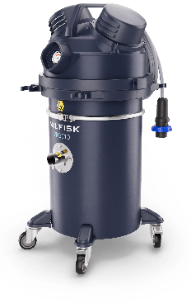



Spare filters and bags filters for VHS010...
VHS010 LC Z22 EXA / C2D2, VHS010 HC Z22 EXA / C2D2 and VHS010 LC ACD
HEPA14 spare filter: Z8 17262
5 PC fleece filter: 107419592
1 PC safe bag system: 4084001573
107419592
4084001573
Z8 17262*
* Refer to user manual and spare part list for maintenance and spare kits

Slide 26
5
Technical specification

Slide 27




Mini IVS technical data CE 230V
Technical data | Unit | VHS010 LC ACD | VHS010 HC ACD | VHS011 LC ACD | VHS010 LC Z22 EXA | VHS010 HC Z22 EXA | VHS011 LC Z22 EXA
PN |  | 4010100122 | 4010100123 | 4010100120 | 4010100115 | 4010100116 | 4010100113
Voltage | V | 230 | 230 | 230 | 230 | 230 | 230
Frequency | Hz | 50 | 50 | 50 | 50 | 50 | 50
Protection class | IP | 44 | 44 | 44 | 65 | 65 | 65
Insulation class | Class | I | I | I | I | I | I
Rated power | kW | 0,9 | 0,9 | 0,9 | 0,95 | 0,95 | 0,95
Max airflow | L/min – m³/h | 2750 – 165 | 2750 – 165 | 2750 – 165 | 3466 – 208 | 3466 – 208 | 3466 – 208
Airflow with 3-meter hose | L/min – m³/h | 2500 – 150 | 2500 – 150 | 2416 – 145 | 2833 – 170 | 2833 – 170 | 2750 - 165
Vacuum max | kPa – mbar | 21 – 210 | 21 – 210 | 21 – 210 | 21 – 210 | 21 – 210 | 21 – 210
Sound pressure level | dB(A) | 70 | 70 | 70 | 72 | 72 | 72
Container capacity | L | 30 | 30 | 15 | 30 | 30 | 15
Main filter type |  | Fleece filter class M | Safe bag system | M Class Cartridge | Fleece filter class M | Safe bag system | M Class Cartridge
Main filter area | cm² | – | – | 9000 | – | – | 9000
Upstream HEPA filter H14 area | cm² | 11000 | 11000 | – | 11000 | 11000 | –
Inlet | mm | 40 | 40 | 40 | 40 | 40 | 40
Length x Width x Height | cm | 41x42x77 | 41x42x77 | 41x42x77 | 41x43x83 | 41x43x83 | 41x43x83
Weight | kg | 18 | 18 | 18 | 21 | 21 | 21

Slide 28
Mini IVS technical data UL 120V
Technical data | Unit | VHS010N1 LC ACD | VHS010N1 HC ACD | VHS011N1 LC ACD AU | VHS010N1 LC C2D2 | VHS010N1 HC C2D2 | VHS011N1 LC C2D2 AU
 |  | 4010100129 | 4010100130 | 4010100128 | TBD | TBD | 4010100119
Voltage | V | 120 | 120 | 120 | 120 | 120 | 120
Frequency | Hz | 60 | 60 | 60 | 60 | 60 | 60
Protection class | IP | 44 | 44 | 44 | 65 | 65 | 65
Insulation class | Class | I | I | I | I | I | I
Rated power | kW | 0,9 | 0,9 | 0,9 | 0,95 | 0,95 | 0,95
Max airflow | L/min – m³/h | 2833 – 170 | 2833 – 170 | 2833 – 170 | 3583 – 215 | 3583 – 215 | 3583 – 215
Airflow with 3-meters hose | L/min – m³/h | 2416 – 145 | 2416 – 145 | 2333 – 140 | 2833 – 170 | 2833 – 170 | 2583 – 155
Airflow with 3-meters hose | cfm | 85 | 85 | 83 | 100 | 100 | 91
Vacuum max | kPa – mbar | 20 – 200 | 20 – 200 | 20 – 200 | 21 – 210 | 21 – 210 | 21 – 210
Sound pressure level | dB(A) | 70 | 70 | 70 | 72 | 72 | 72
Container capacity | L | 30 | 30 | 15 | 30 | 30 | 15
Main filter type |  | Fleece filter class M | Safe bag system | M Class Cartridge | Fleece filter class M | Safe bag system | M Class Cartridge
Main filter area | cm² | – | – | 9000 | – | – | 9000
Upstream HEPA filter H14 area | cm² | 11000 | 11000 | 11000 | 11000 | 11000 | 11000
Inlet | mm | 40 | 40 | 40 | 40 | 40 | 40
Length x Width x Height | cm | 41x42x77 | 41x42x77 | 41x42x77 | 41x43x83 | 41x43x83 | 41x43x83
Weight | kg | 18 | 18 | 18 | 21 | 21 | 21

Slide 29
Mini IVS technical data UK 110V
Technical data | Unit | VHS010 HC ACD V110 UKP | VHS010 HC ACD UKP | VHS011 LC ACD V110 UKP | VHS010 LC Z22 EXA V110 UKP | VHS010 HC Z22 EXA V110 UKP | VHS011 LC Z22 EXA V110 UKP
 |  | 4010100125 | 4010100127 | 4010100124 | TBD | 4010100118 | 4010100117
Voltage | V | 110 | 220 | 110 | 110 | 110 | 110
Frequency | Hz | 50 | 50 | 50 | 50 | 50 | 50
Protection class | IP | 44 | 44 | 44 | 65 | 65 | 65
Insulation class | Class | I | I | I | I | I | I
Rated power | kW | 0,9 | 0,9 | 0,9 | 0,95 | 0,95 | 0,95
Max airflow | L/min – m³/h | 2666 – 160 | 2750 – 165 | 2666 – 160 | 3333 – 200 | 3333 – 200 | 3333 – 200
Airflow with 3-meter hose | L/min – m³/h | 2333 – 140 | 2500 – 150 | 2250 – 135 | 2666 – 160 | 2666 – 160 | 2666 – 160
Vacuum max | kPa – mbar | 17,5 – 175 | 21 – 210 | 17,5 – 175 | 19 – 190 | 19 – 190 | 19 – 190
Sound pressure level | dB(A) | 70 | 70 | 70 | 72 | 72 | 72
Container capacity | L | 30 | 30 | 15 | 30 | 30 | 15
Main filter type |  | Safe bag system | Safe bag system | M Class Cartridge | Fleece filter class M | Safe bag system | M Class Cartridge
Main filter area | cm² | – | – | 9000 | – | – | 9000
Upstream HEPA filter H14 area | cm² | 11000 | 11000 | – | 11000 | 11000 | –
Inlet | mm | 40 | 40 | 40 | 40 | 40 | 40
Length x Width x Height | cm | 41x42x77 | 41x42x77 | 41x42x77 | 41x43x83 | 41x43x83 | 41x43x83
Weight | kg | 18 | 18 | 18 | 21 | 21 | 21

Slide 30
6
Naming and product hierarchy

Slide 31




Naming and product hierarchy
L3 = Single-phase explosion proof
L4 = VHS01 Z22
L5 = VHS01 Z22
L6:
VHS010 LC Z22 EXA LC
VHS010 HC Z22 EXA
VHS011 LC Z22 EXA
VHS011 LC Z22 EXA V110 UKP
VHS010 HC Z22 EXA UKP
……..
L4 = VHS01 ACD
L5 = VHS01 ACD
L6:
L6:
VHS010 LC ACD
VHS010 HC ACD
VHS011 LC ACD
VHS011 LC ACD AU
………
L4 = VHS01 C2D2
L5 = VHS01 C2D2
L6:
VHS011 C2D2 AU
VHS011 C2D2 AU 3X FPAT
VHS010 C2D2 HC ACD
…………
VHS010 HC Z22 EXA
S: Single
Phase
0: Safe disposal
1: Pull&Clean version
Acronyms
1: motor
0: 320 mm platform
VHS010 LC ACD
S: Single
Phase
0: Safe disposal
1: Pull&Clean version
Acronyms
1: motor
0: 320 mm platform

Slide 32



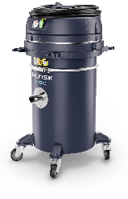
PNs and versions available at launch date
Model type | PN
VHS010 HC ACD UKP | 4010100127 | UK
VHS010 HC ACD V110 UKP | 4010100125
VHS011 LC ACD UKP | 4010100126
VHS011 LC ACD V110 UKP | 4010100124
VHS010 HC Z22 EXA V110 UKP | 4010100118
VHS011 LC Z22 EXA V110 UKP | 4010100117
VHS010 LC ACD | 4010100122 | EU
VHS010 HC ACD | 4010100123
VHS011 LC ACD | 4010100120
VHS011 LC ACD AU | 4010100121
VHS010 LC Z22 EXA | 4010100115
VHS010 HC Z22 EXA | 4010100116
VHS011 LC Z22 EXA | 4010100113
VHS011 LC Z22 EXA AU | 4010100114
VHS010N1 HC ACD | 4010100130 | US
VHS010N1 LC ACD | 4010100129
VHS011N1 LC ACD AU | 4010100128
VHS011N1 LC C2D2 AU | 4010100119

